Slide 1

How to Add Payment Methods to TechSoup Cloud Manager

Slide 2
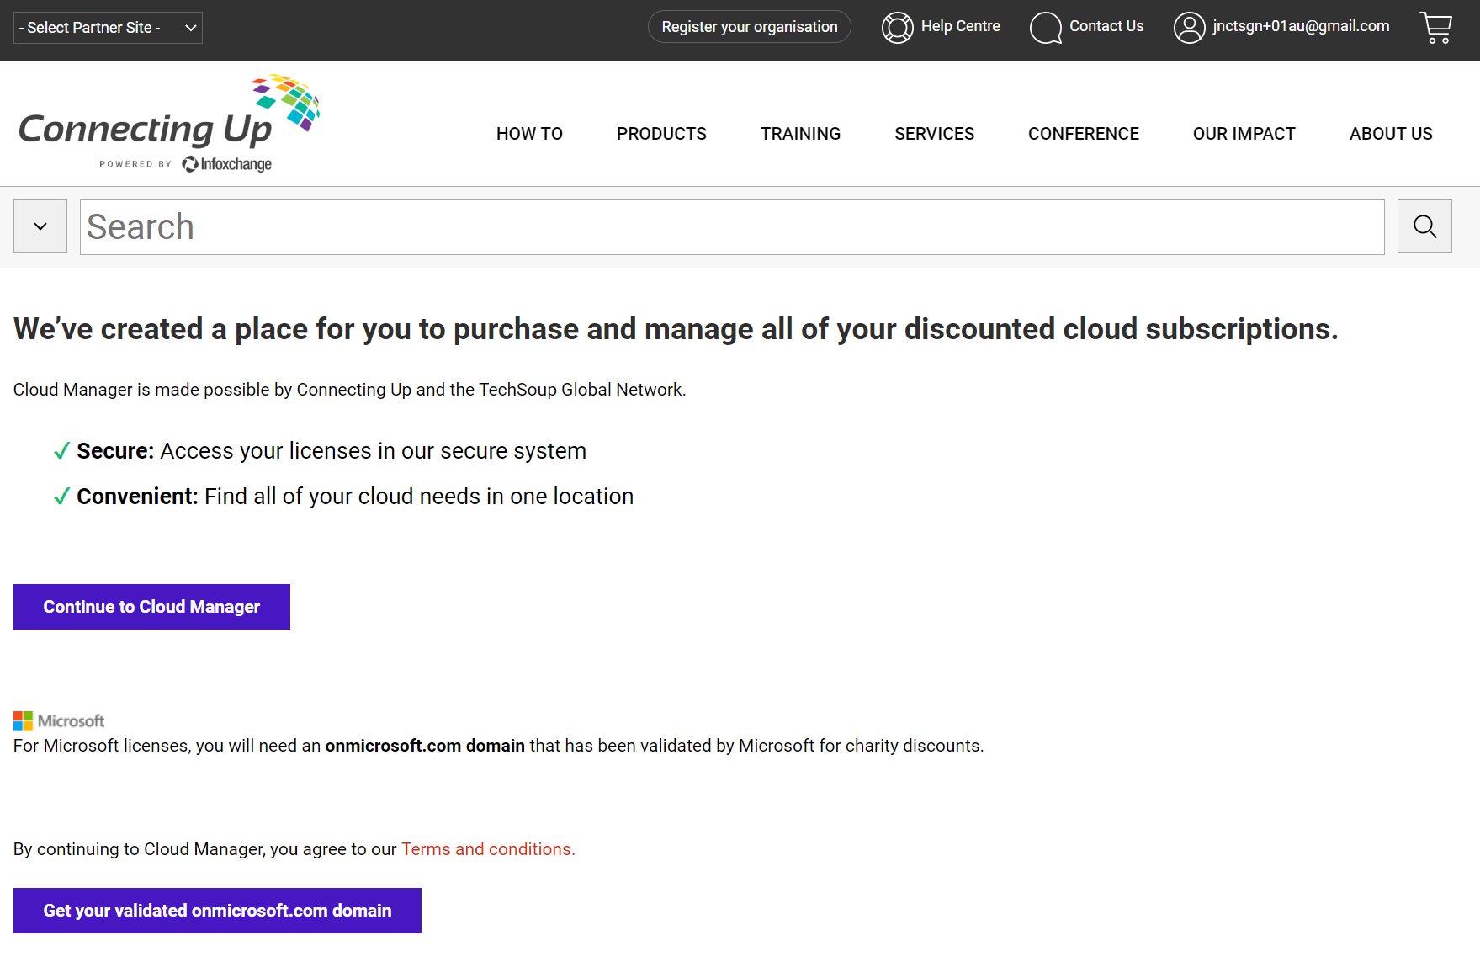
These instructions will show you how to add payment information to your TechSoup Cloud Manager account.
1
Log in to TechSoup Cloud Manager via Partner Platform.
Or copy and paste this URL into your browser address bar: https://www.connectingup.org/donations/cloud-manager/introducing
How to Add Payment Methods to TechSoup Cloud Manager

Slide 3
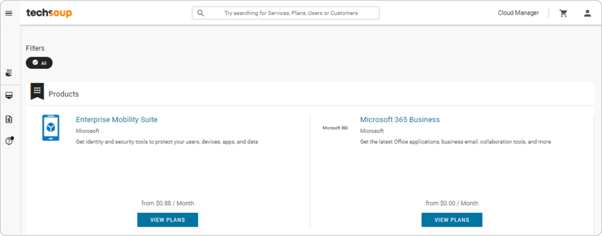
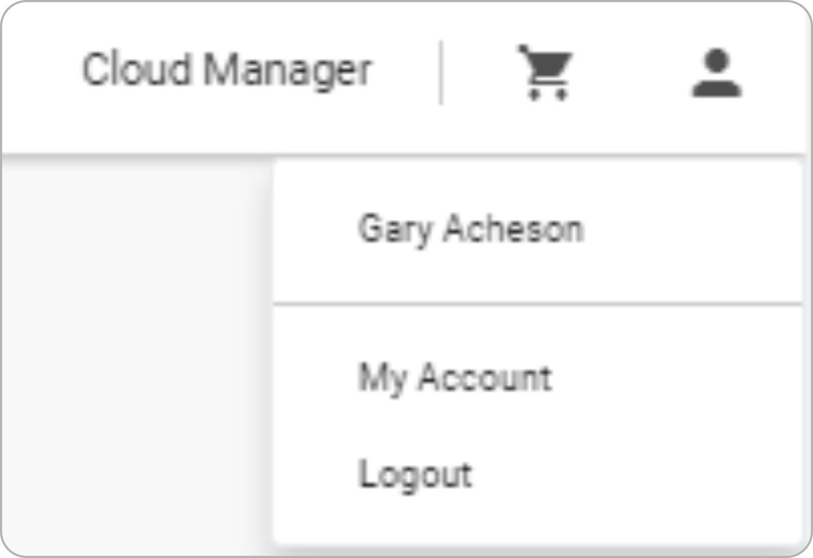
2
You are now
logged into TechSoup's Cloud Manager.
3
Click the icon
shaped like a person in the top right of your browser window and
choose My Account.
How to Add Payment Methods to TechSoup Cloud Manager

Slide 4
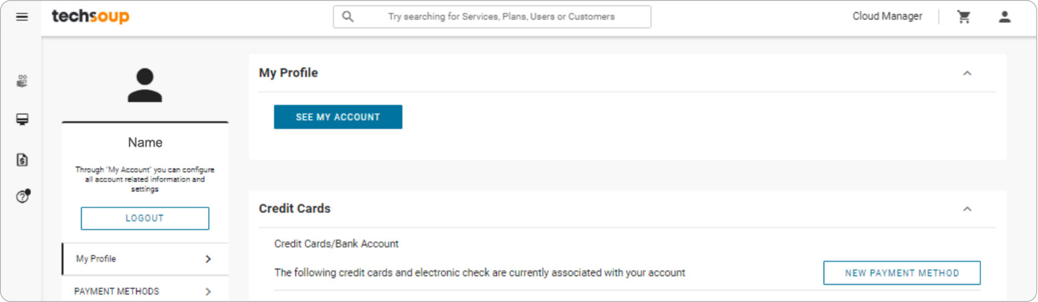
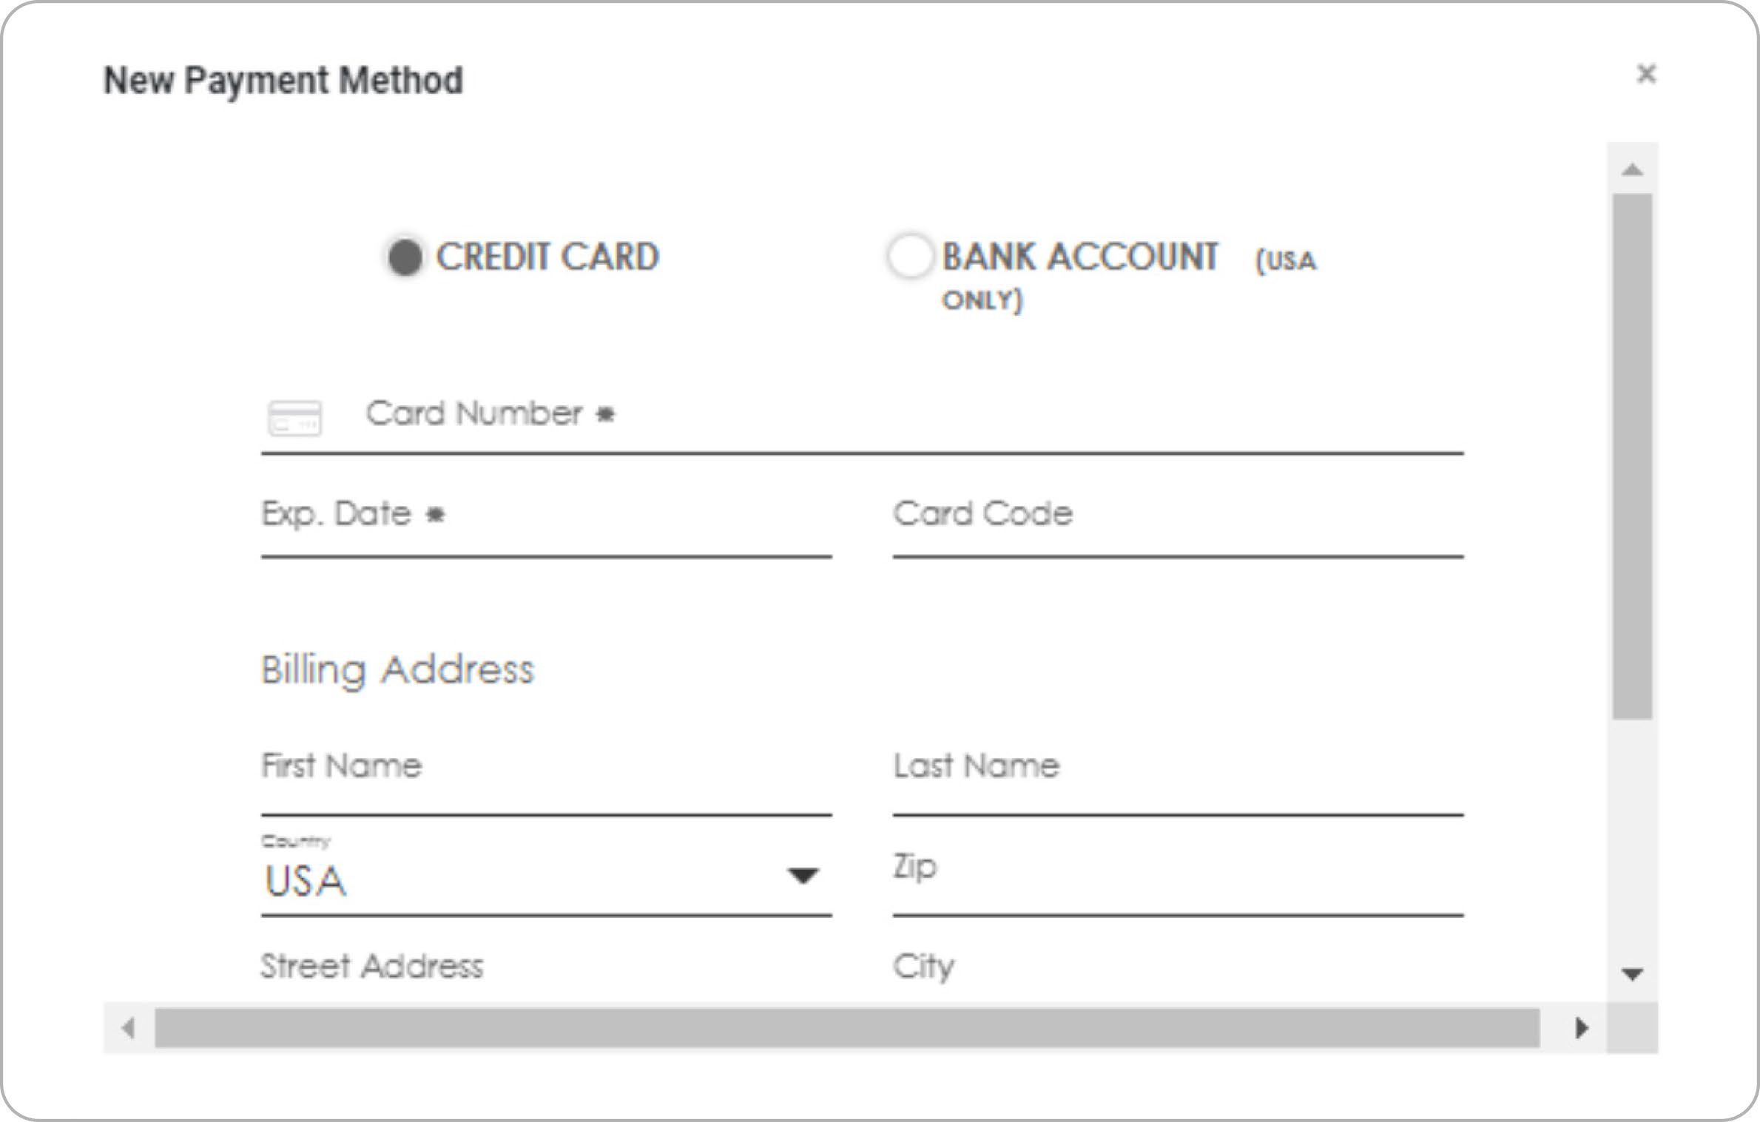
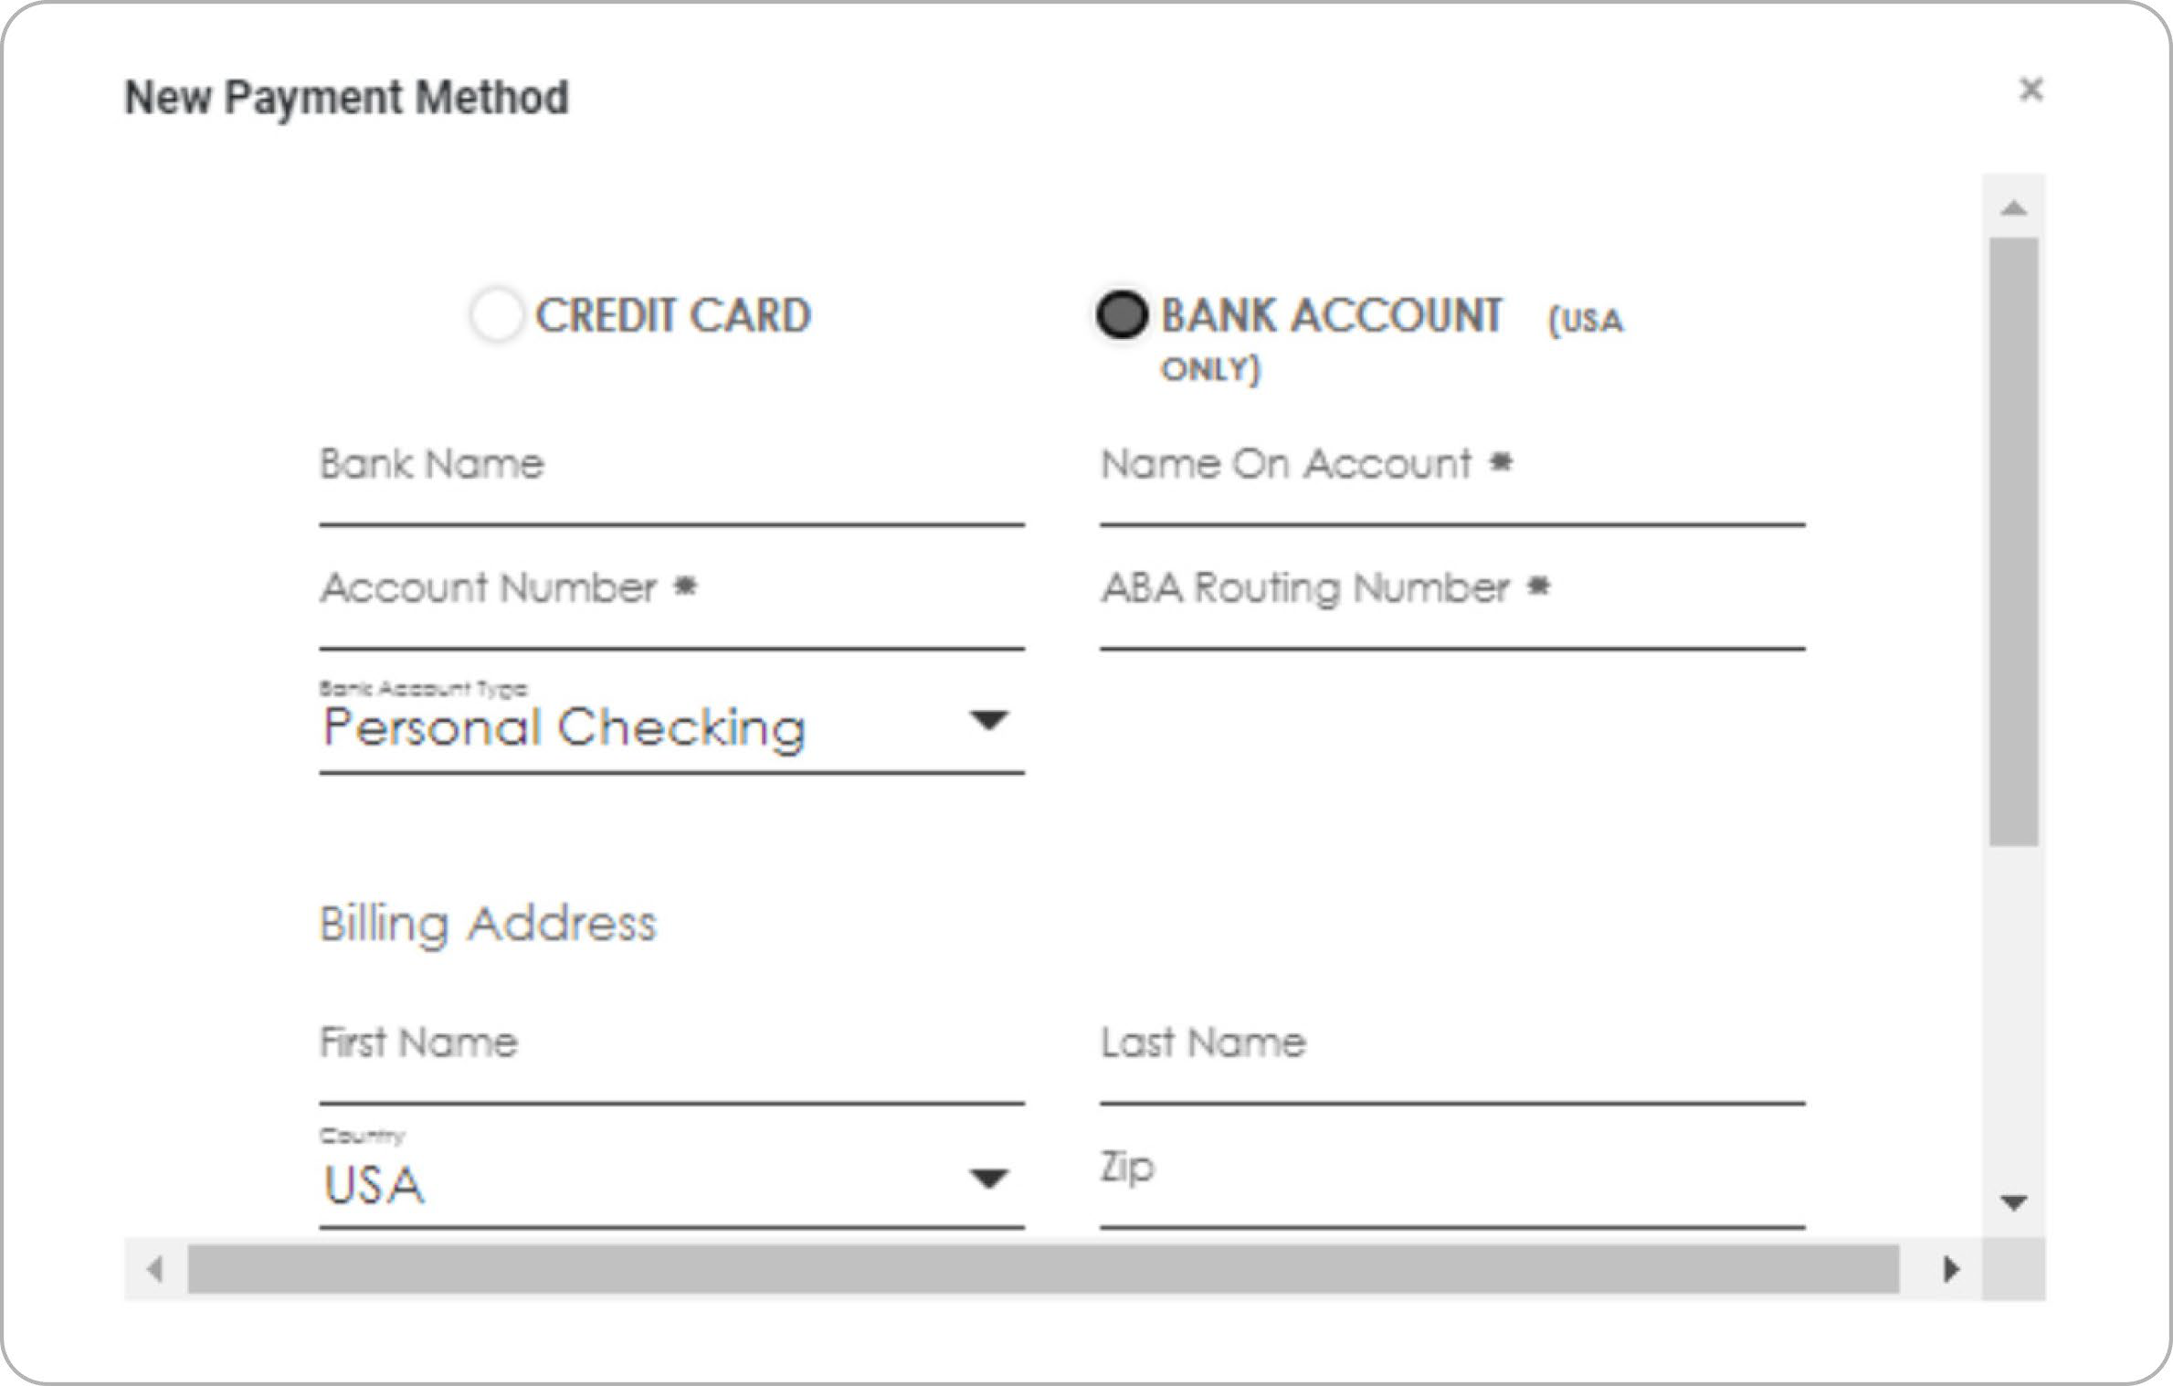
4
Under the section called Credit Cards, click
the NEW PAYMENT
METHOD button.
5
Enter your payment details.
CREDIT CARD
is the default selection. However, you may also choose
BANK ACCOUNT
as your payment method.
6
Click SAVE.
How to Add Payment Methods to TechSoup Cloud Manager

Slide 5
How Can TechSoup Help You?
SERVICES
TRAINING
COMMUNITY
We have services that range from license activation, migration, security assessment, and setting up multi- factor authentication to a full Office 365 Complete Setup that will help you get up and running.
You can reach us via one of the following methods:
We offer training courses for nonprofit staff and volunteers on how to use Microsoft applications such as Teams, Excel, PowerPoint, Word, SharePoint, and many other applications.
Start learning: https://techsoup.course.tc/ catalog?type=microsoft-digital-skills-center
Be a part of our community!
http://forums.techsoup.org/cs/community/ f/112.aspx
Via phone 1-800-659-3579.
Monday through Friday
from 7 a.m. to 12 p.m. Pacific time
Create a support ticket: https://page.techsoup.org/office-365- support-services

Slide 6
techsoup.org

