Slide 1

How to Find TechSoup
Subscription Renewal
Information

Slide 2
Information such as subscription renewal term date, activation date, and payment information can be accessed via one of the following methods.
Cloud Manager will show all subscriptions and licenses obtained through TechSoup, including any licenses that may in future include support fees.
Microsoft Admin Center will show all subscriptions and licenses obtained from TechSoup and other providers, such as Microsoft Direct.
Via TechSoup Cloud Manager
Via the Microsoft Admin Center
2 How to Find Subscription Renewal Information

Slide 3

Option 1:
TechSoup Cloud Manager

Slide 4
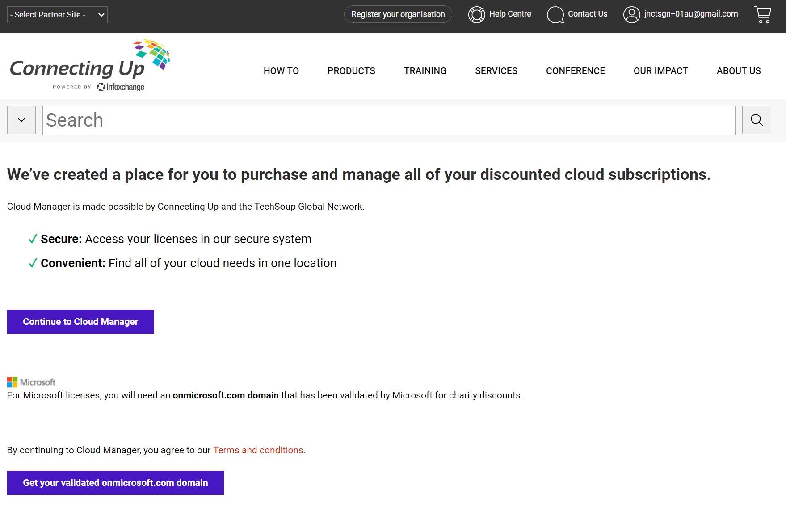
These instructions will show you how to add payment information to your TechSoup Cloud Manager account.
1
Log in to TechSoup Cloud Manager via Partner Platform.
Or copy and paste this URL into your browser address bar: https://www.connectingup.org/donations/cloud-manager/introducing
How to Add Payment Methods to TechSoup Cloud Manager

Slide 5
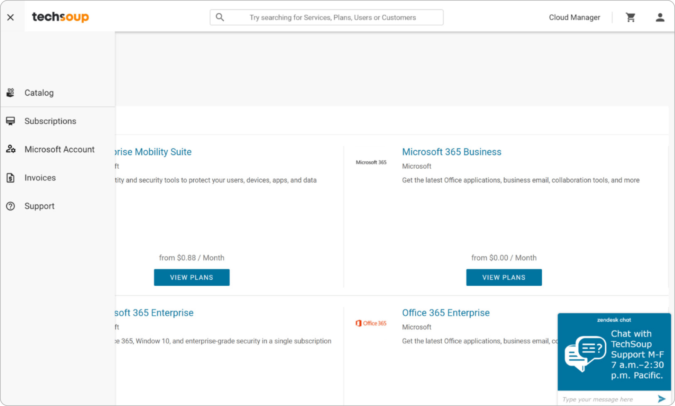
2
Choose Subscriptions
in the icon menu on the left. These are the subscriptions obtained through TechSoup.
If these subscriptions include Office 365 E1 (donation), Microsoft 365 Business Basic,
or Microsoft 365 Business Premium
(10-seat donation), these subscriptions will include support fees upon term renewal
on or after January 4, 2023.
How to Find Subscription Renewal Information
Option 1: TechSoup Cloud Manager

Slide 6
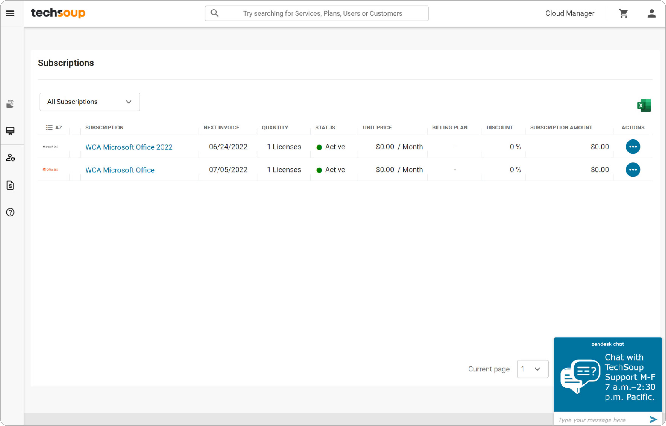
3
Select a subscription.
How to Find Subscription Renewal Information
Option 1: TechSoup Cloud Manager

Slide 7
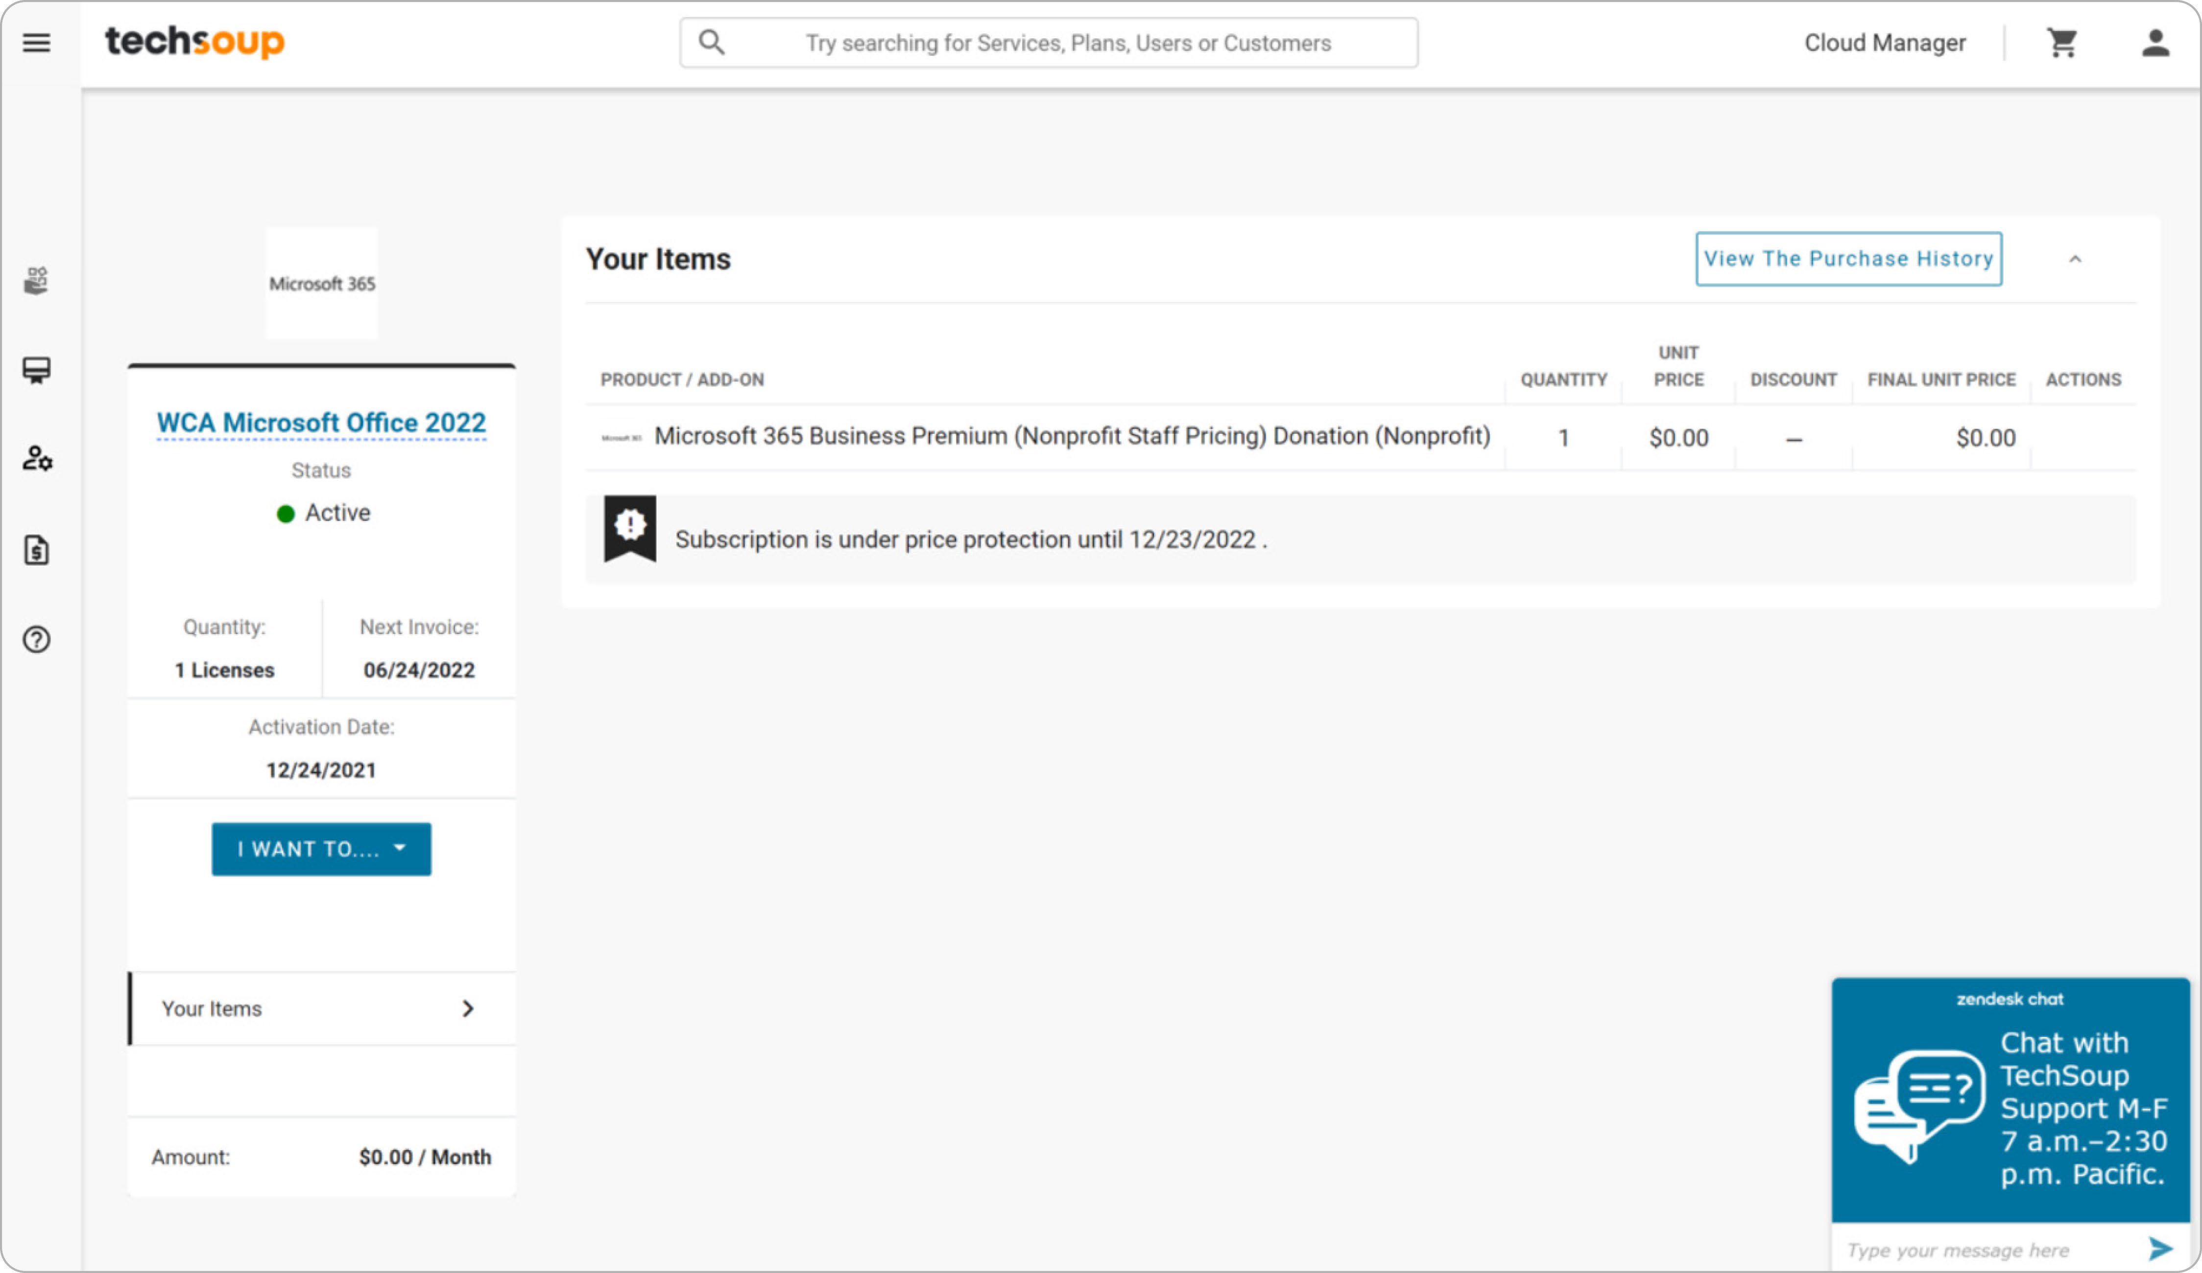
4
View subscription renewal information such as
Next Invoice date, Activation date,
and Price Protection date
— your rate is normally guaranteed for one year after the activation date.
How to Find Subscription Renewal Information
Option 1: TechSoup Cloud Manager

Slide 8

Option 2:
Microsoft Admin Center
8 How to Find Subscription Renewal Information Option 2: Microsoft Admin Center

Slide 9
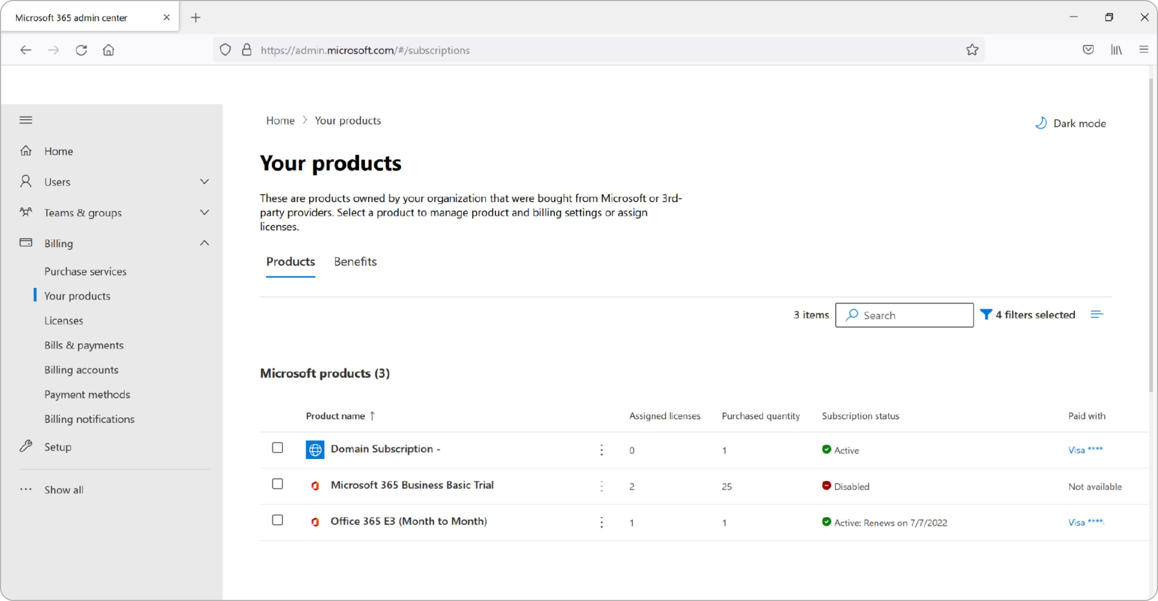
1
Log in to your organization's Microsoft Admin Center.
Access credentials are generally in the format name@organizationname.onmicrosoft.com and a password.
2
Choose Billing, select Your products
in the menu on the left, and select a subscription.
How to Find Subscription Renewal Information
Option 2: Microsoft Admin Center

Slide 10
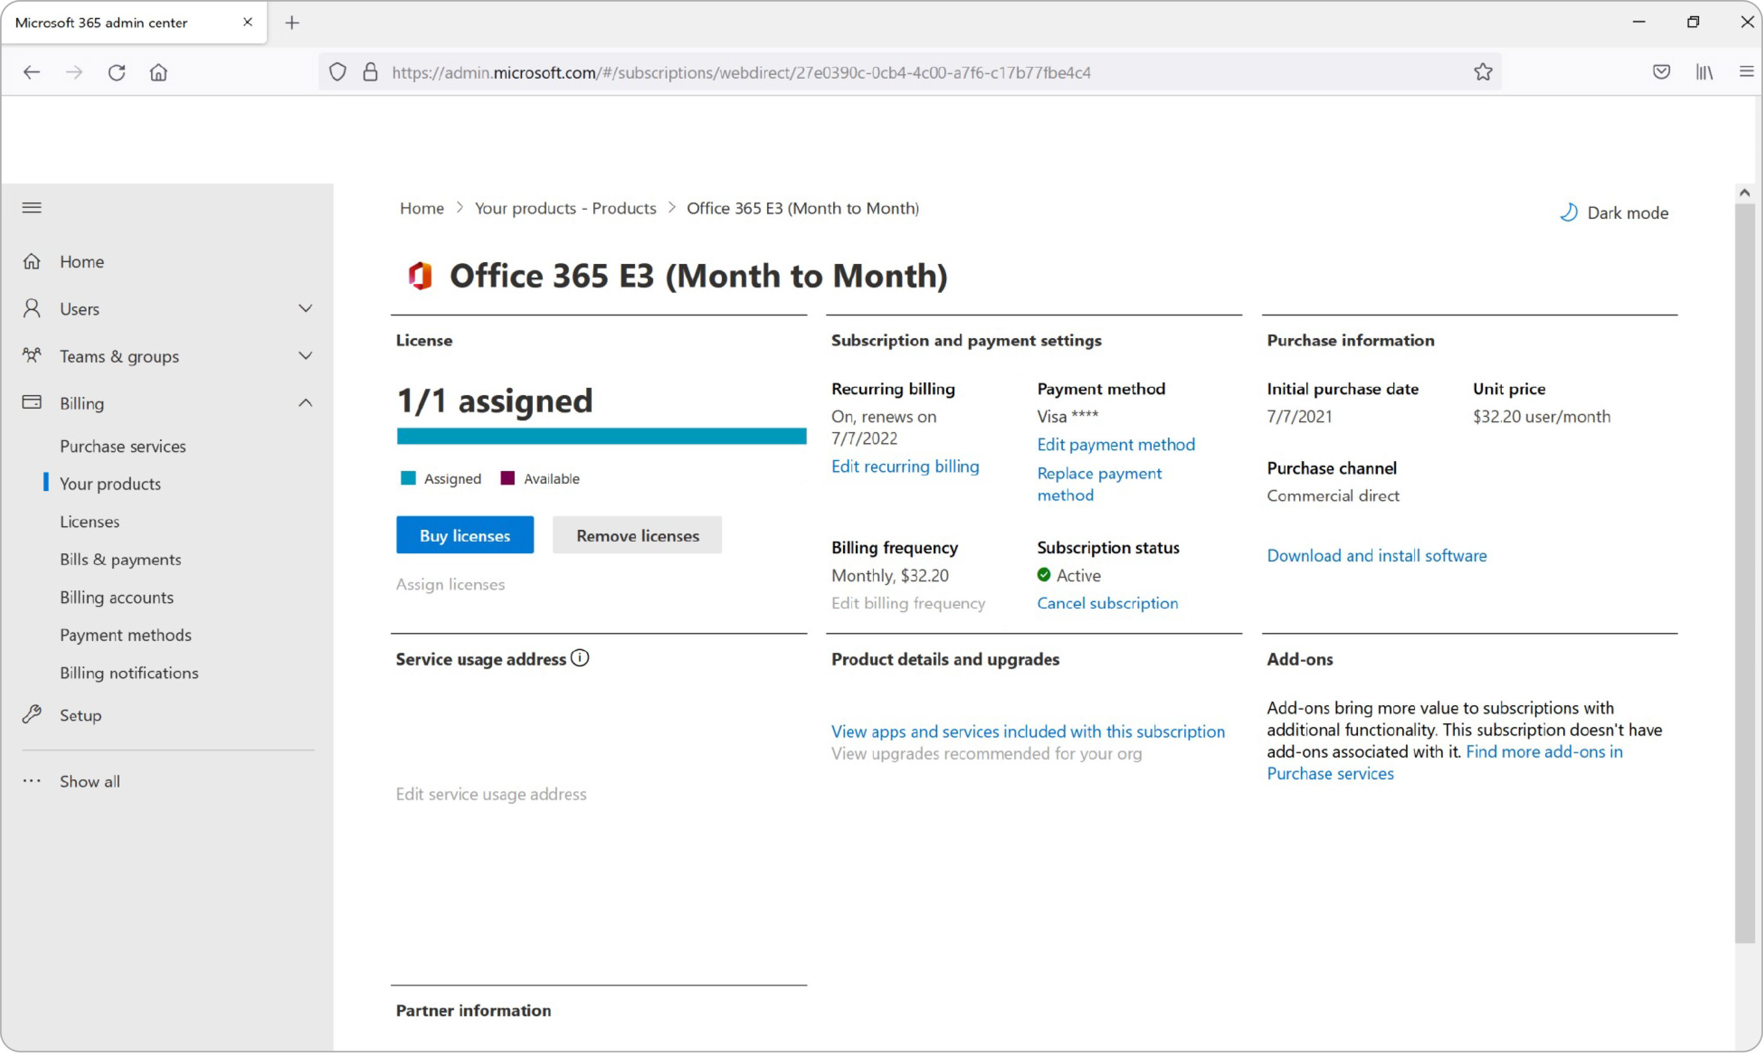
3
View subscription renewal details such as
the Renew On date, Initial Purchase date, and Billing Frequency (monthly or annually).
How to Find Subscription Renewal Information
Option 2: Microsoft Admin Center

Slide 11

How Can TechSoup Help You?
SERVICES
TRAINING
COMMUNITY
We have services that range from license activation, migration, security assessment, and setting up multi- factor authentication to a full Office 365 Complete Setup that will help you get up and running.
You can reach us via one of the following methods:
We offer training courses for nonprofit staff and volunteers on how to use Microsoft applications such as Teams, Excel, PowerPoint, Word, SharePoint, and many other applications.
Start learning: https://techsoup.course.tc/ catalog?type=microsoft-digital-skills-center
Be a part of our community!
http://forums.techsoup.org/cs/community/ f/112.aspx
Via phone 1-800-659-3579.
Monday through Friday
from 7 a.m. to 12 p.m. Pacific time
Create a support ticket: https://page.techsoup.org/office-365- support-services

Slide 12

techsoup.org

