Slide 1

How to Move from TechSoup-Supported Licenses to Microsoft Direct

Slide 2
The best way to do this is in two consecutive parts.
We highly recommend ensuring that new replacement licenses are in place before your current licenses are canceled. This helps make sure that license holders will maintain consistent access to their Microsoft tools.
Part 1: Create Your New Microsoft Direct Licenses
Part 2: Retire Your Current TechSoup Licenses
Disclaimer:
Office 365 E1 donated licenses are no longer available from Microsoft. For up to 300 licenses, Microsoft 365 Business Basic could be an alternative.
2 How to Move from TechSoup-Supported Licenses to Microsoft Direct

Slide 3

Part 1:
Create Replacement Microsoft Direct
Licenses

Slide 4
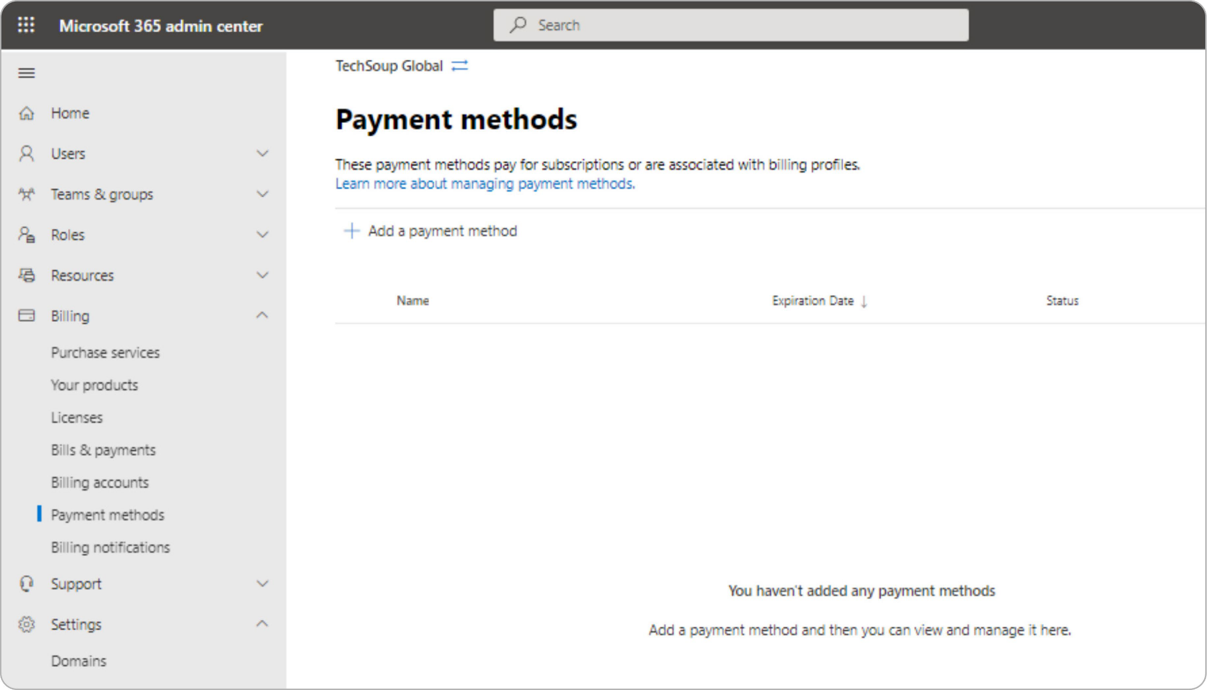
First Step:
Update Payment Information in Microsoft Admin Center
Please note: A credit or debit card is required to be entered into your Microsoft account to obtain licenses from Microsoft, even if the licenses cost $0. Cards accepted are Visa, Mastercard, Discover, or American Express.
1
Log in to your organization's Microsoft Admin Center. Access credentials are generally
in the format name@organizationname. onmicrosoft.com and a password.
2
Choose Billing;
then select Payment methods
in the menu on the left.
Part 1: Create Replacement Microsoft Direct Licenses

Slide 5
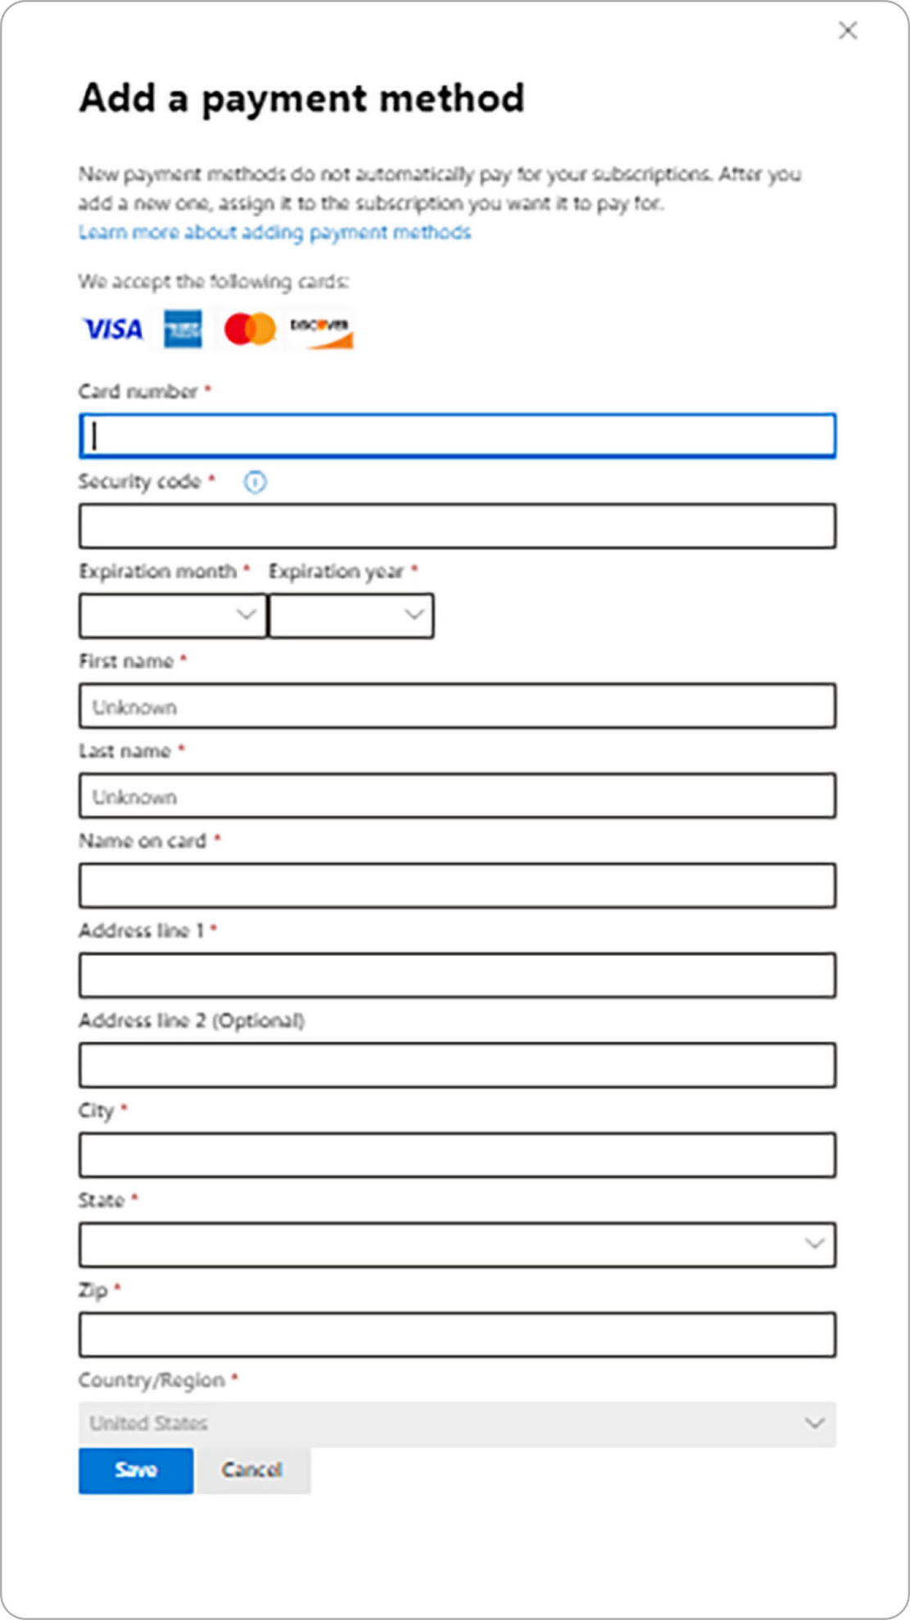
3
Select +Add a payment method,
enter details, and click Save.
Part 1: Create Replacement Microsoft Direct Licenses

Slide 6
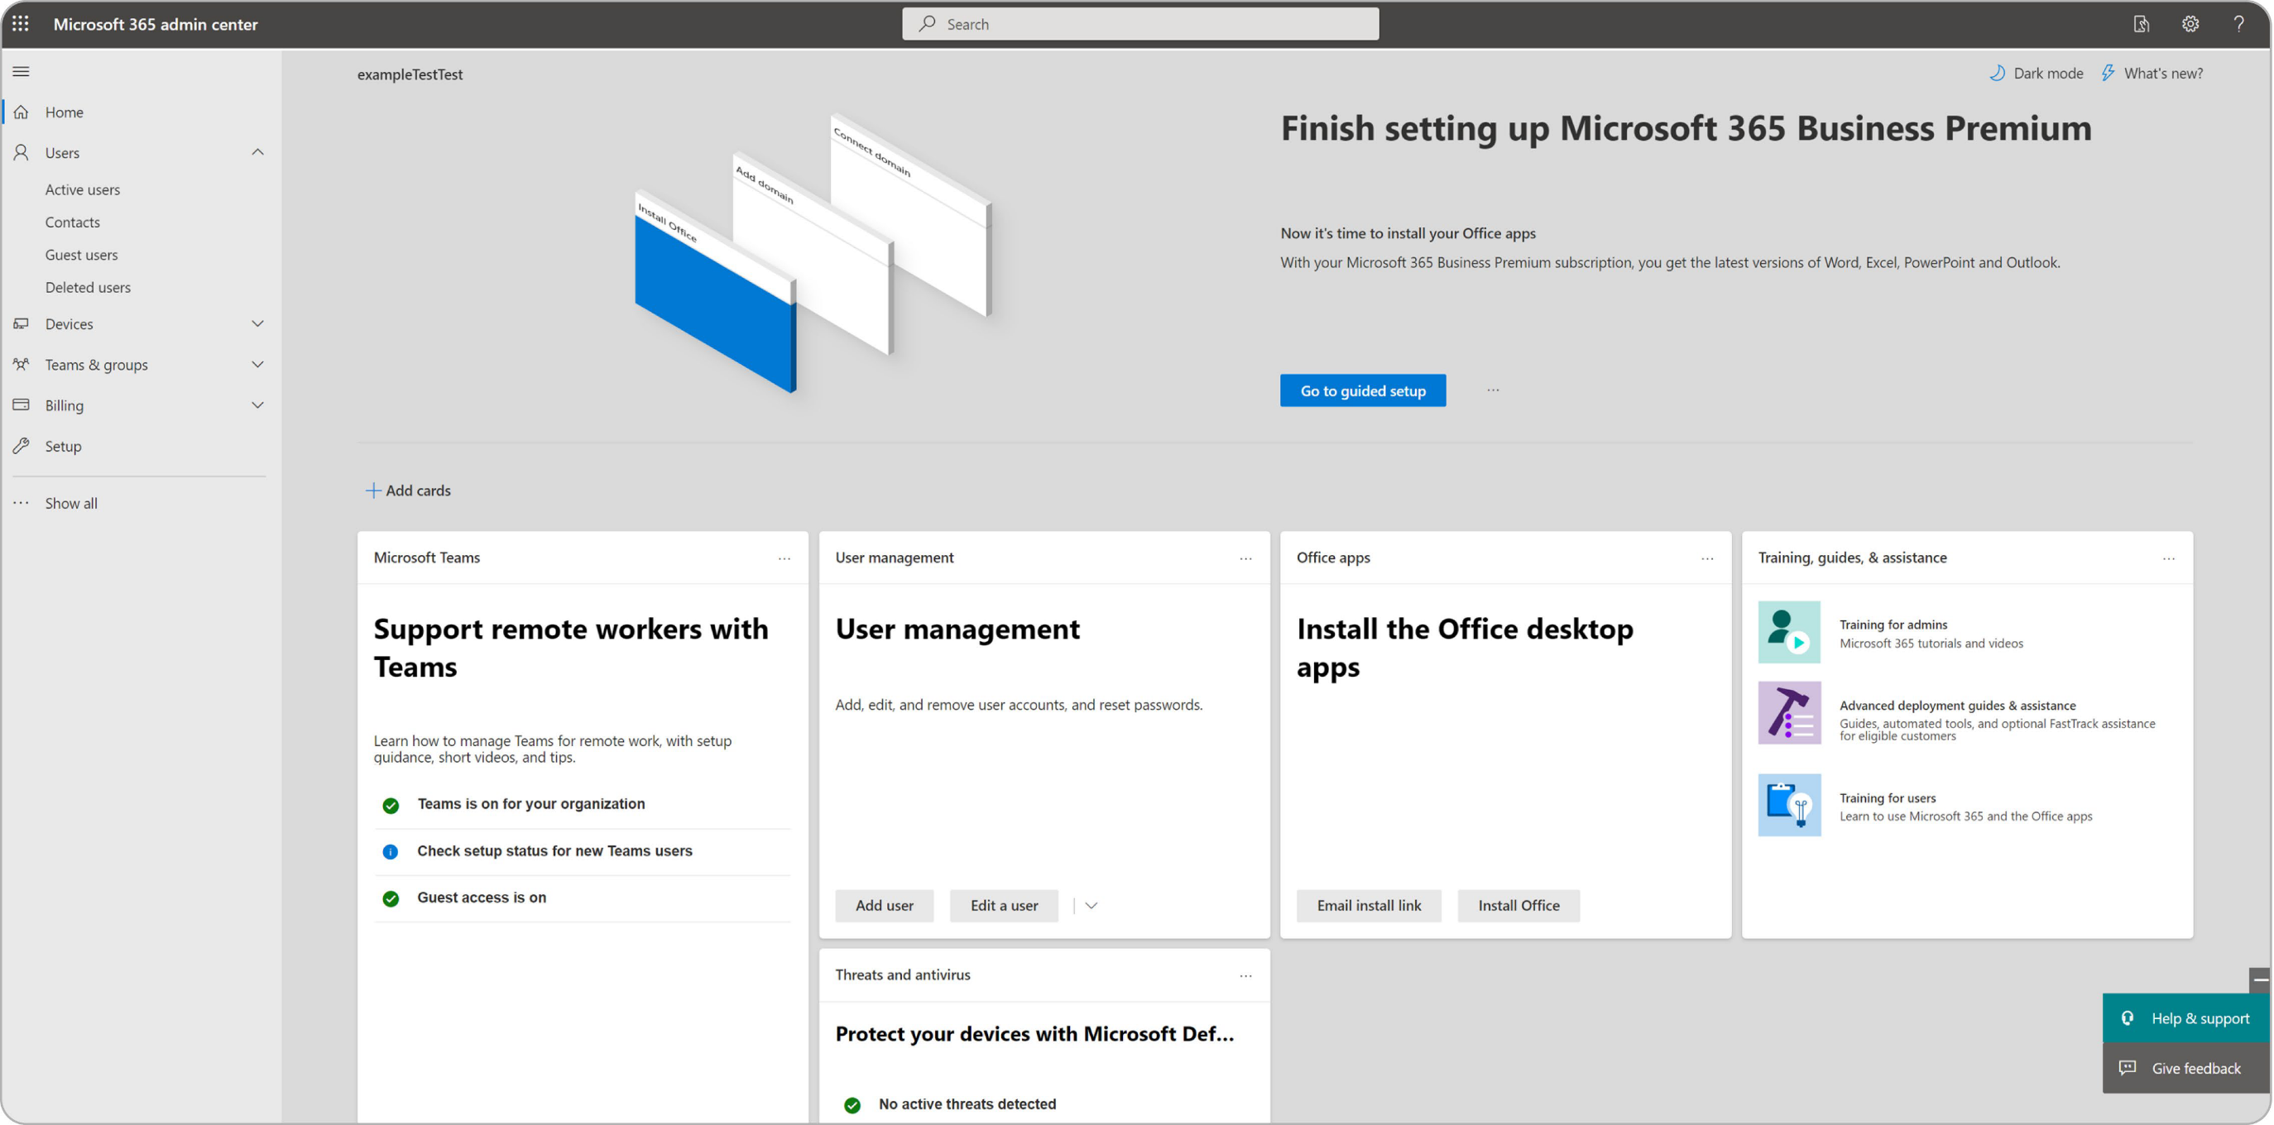
Second Step:
Obtain Replacement Licenses
1
Log in to your organization's Microsoft Admin Center. Access credentials are generally in
the format name@organizationname.onmicrosoft.com and a password. You'll see the screen below.
Part 1: Create Replacement Microsoft Direct Licenses

Slide 7
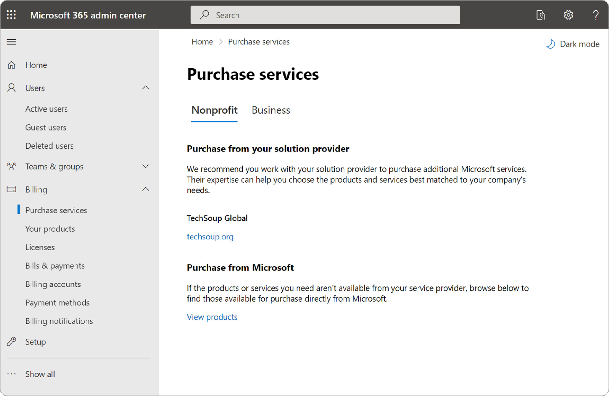
2
Choose Billing; then select
Purchase services
to find your Microsoft product and purchase licenses.
Select Purchase from Microsoft.
* You may need to use Admin in the menu on the left to move to the admin functions.
Part 1: Create Replacement Microsoft Direct Licenses

Slide 8
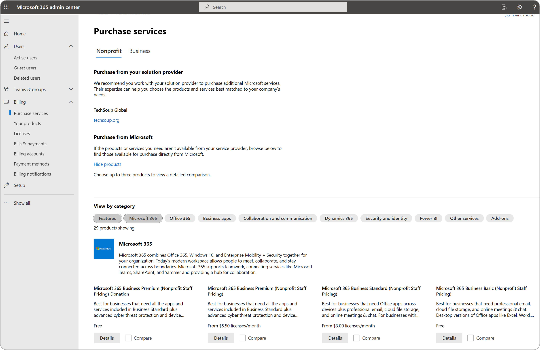
3
Find the licenses you want to get directly from Microsoft. For donated licenses,
select Microsoft 365 and choose the specific license you need.
Part 1: Create Replacement Microsoft Direct Licenses

Slide 9
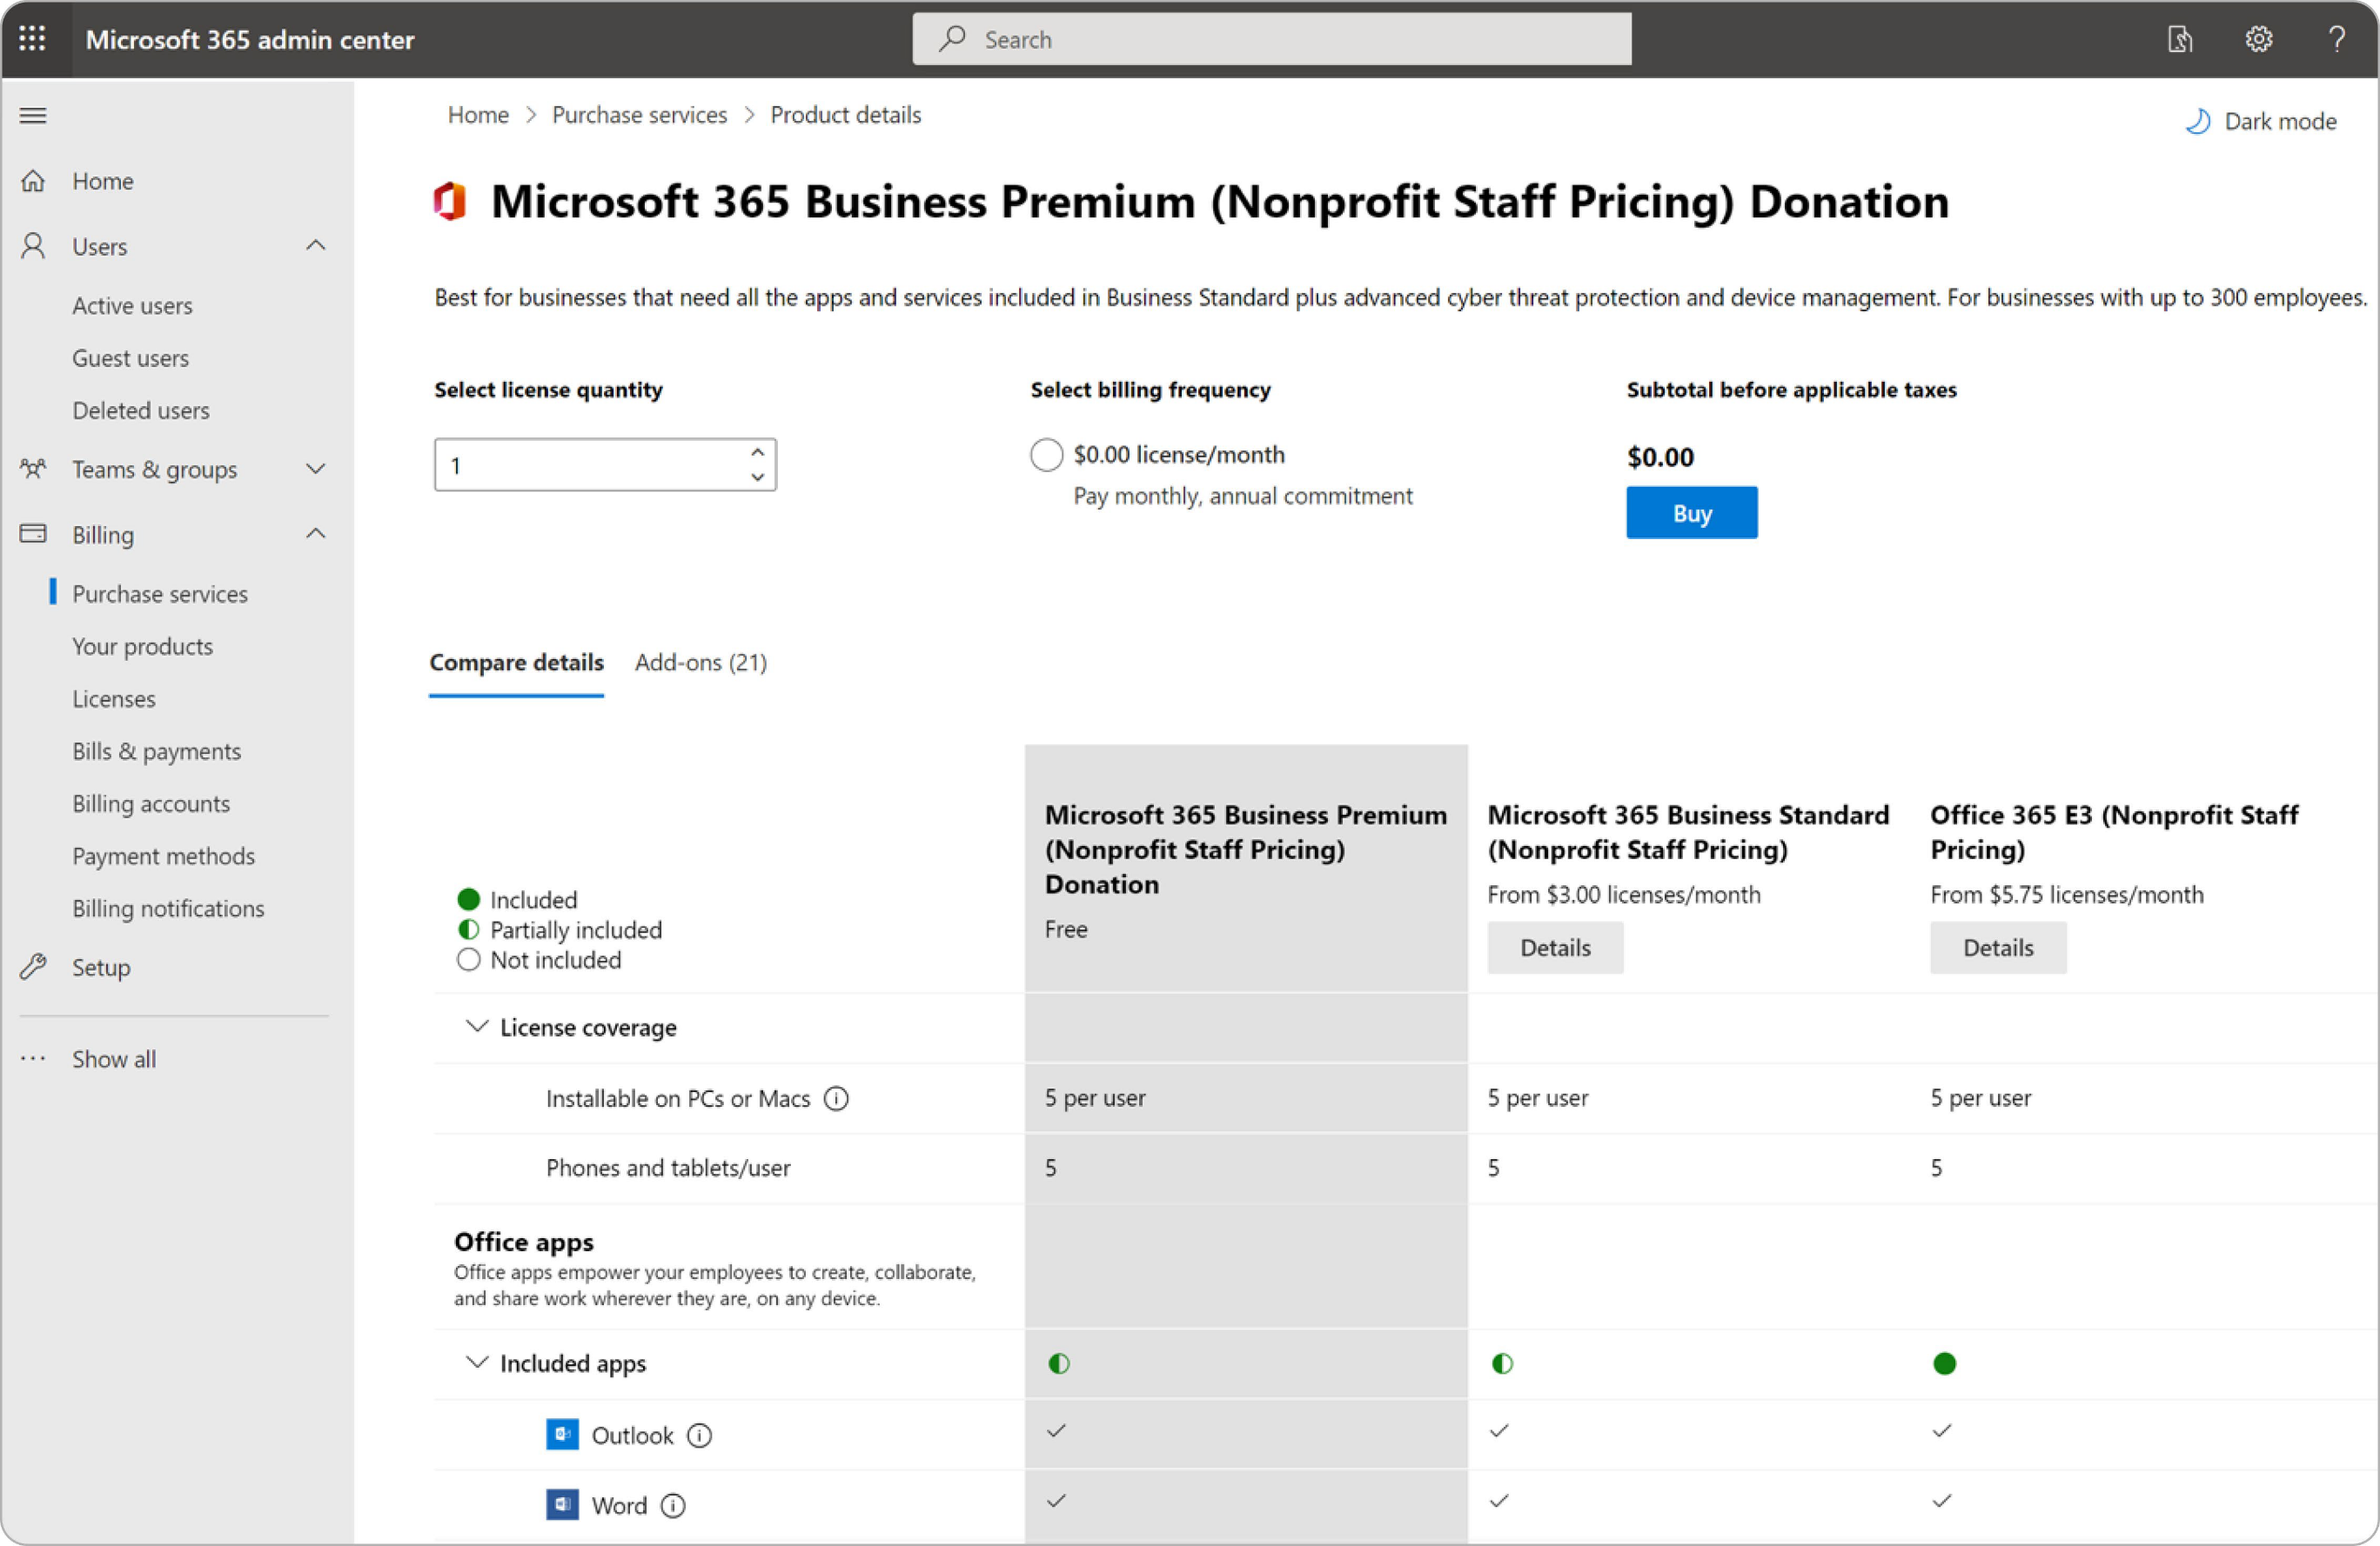
4
Select the quantity of licenses
you want and select Buy.
Part 1: Create Replacement Microsoft Direct Licenses

Slide 10
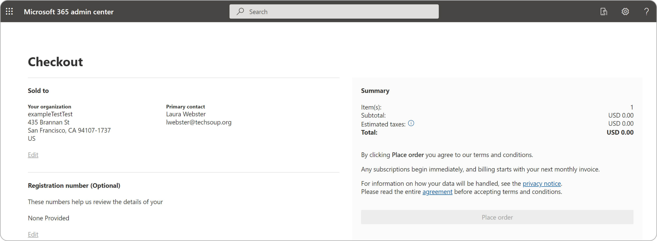
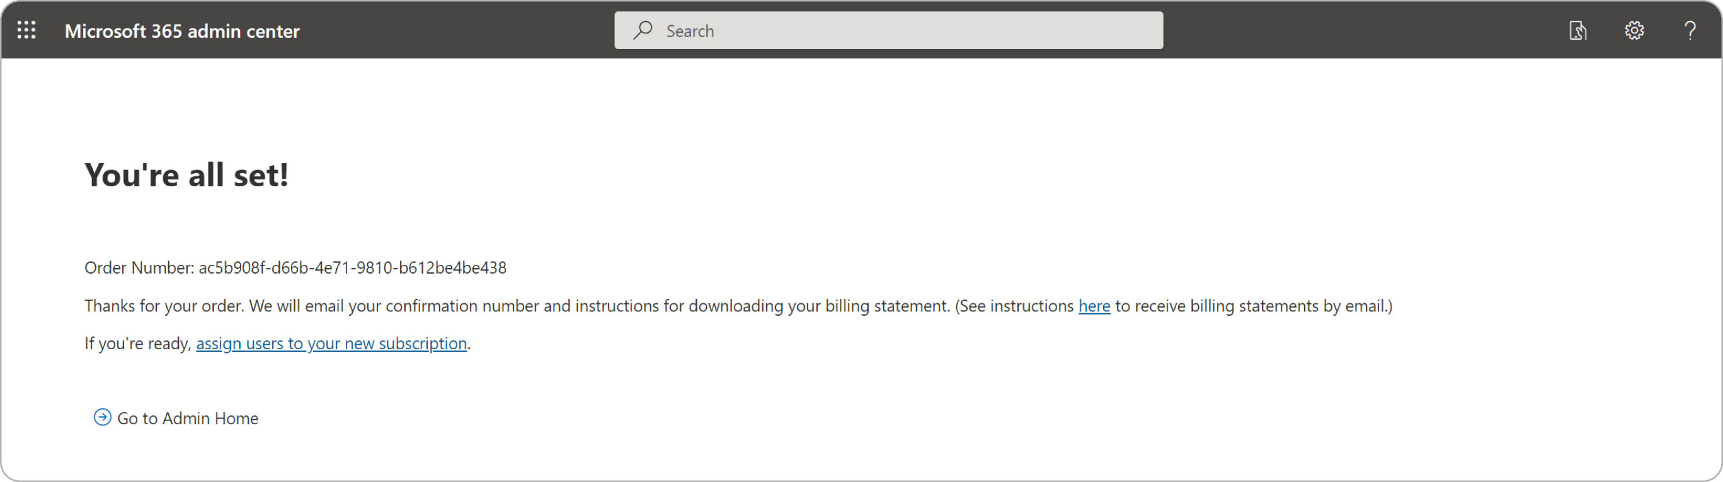
5
Check out and confirm your billing information.
6
Click the Assign users to
your new subscription.
Part 1: Create Replacement Microsoft Direct Licenses

Slide 11
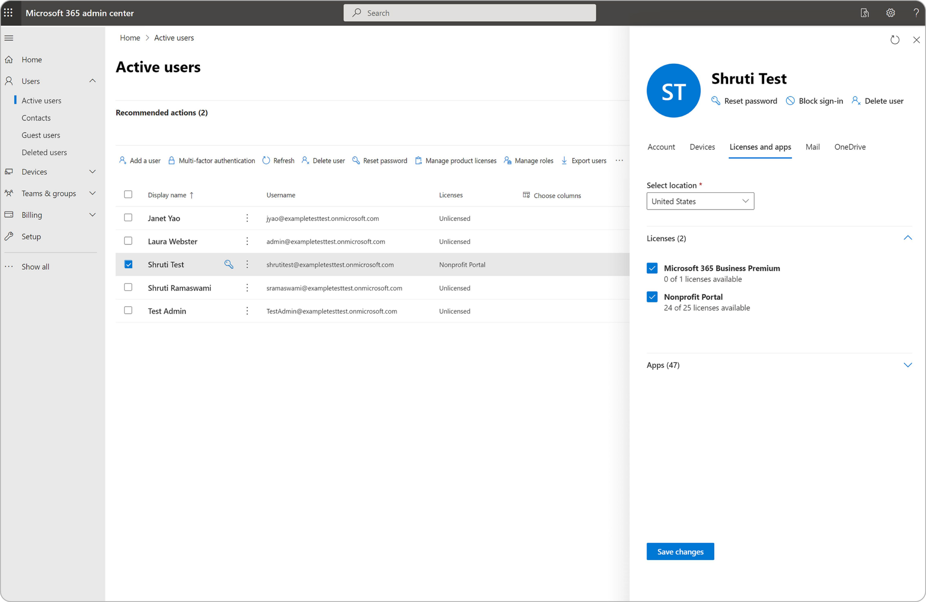
7
Select the user
you want to add the license to. Then the right hand pane will open up.
Select Licenses and Apps
and check the boxes for licenses you want to assign to them.
Remember to
Save your Changes.
Part 1: Create Replacement Microsoft Direct Licenses

Slide 12

Part 2:
Retire Your
Current TechSoup Licenses
12 How to Move from TechSoup-Supported Licenses to Microsoft Direct Part 2: Retire Your Current TechSoup Licenses

Slide 13
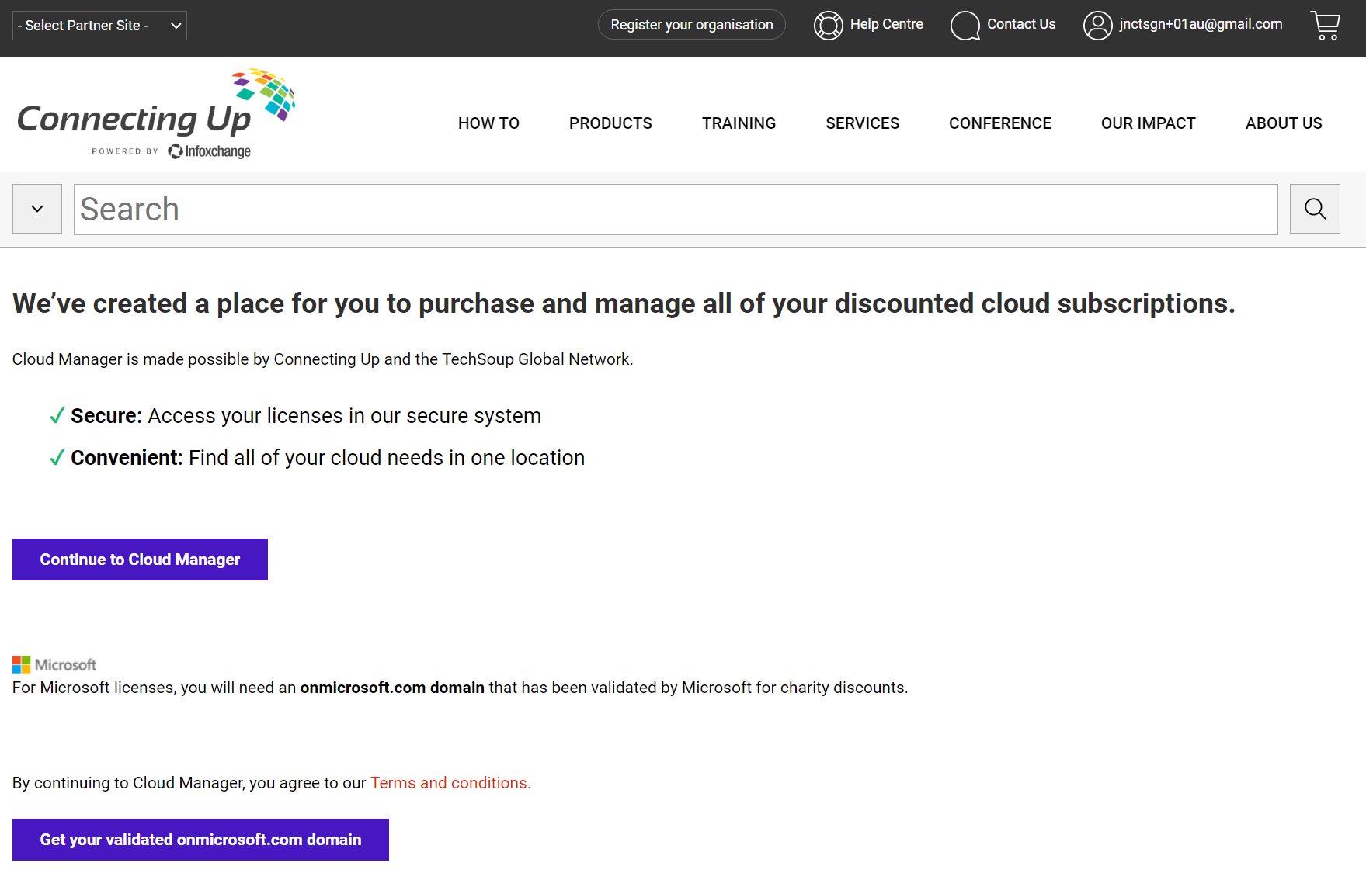
These instructions will show you how to add payment information to your TechSoup Cloud Manager account.
1
Log in to TechSoup Cloud Manager via Partner Platform.
Or copy and paste this URL into your browser address bar: https://www.connectingup.org/donations/cloud-manager/introducing
How to Add Payment Methods to TechSoup Cloud Manager

Slide 14
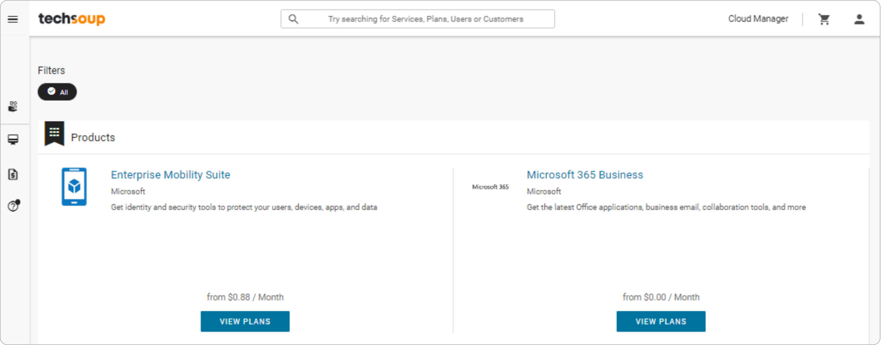
2 You are now logged into TechSoup's Cloud Manager.
Part 2: Retire Your Current TechSoup Licenses

Slide 15
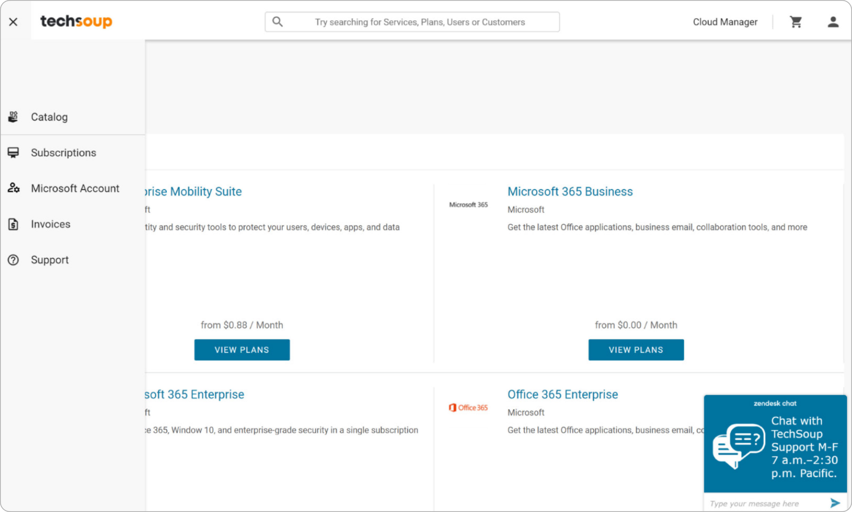
3
Click Subscriptions
in the icon menu on the left.
Part 2: Retire Your Current TechSoup Licenses

Slide 16
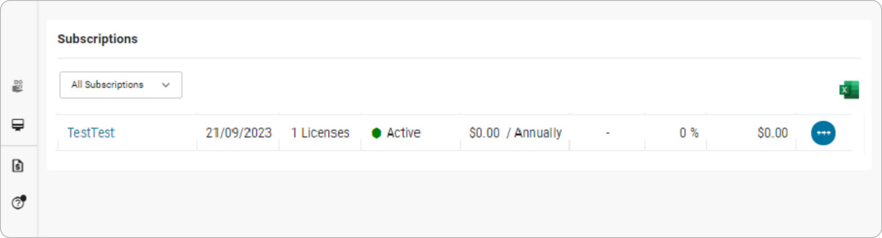
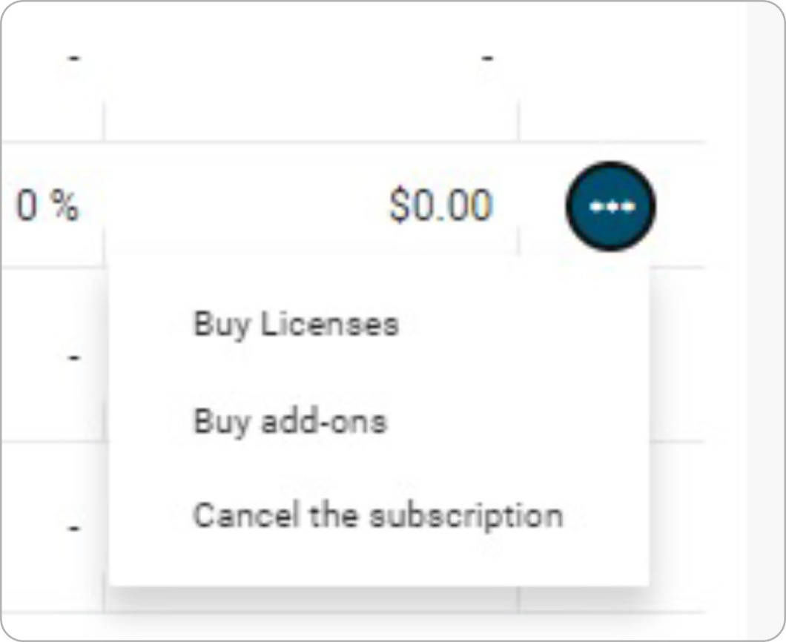
4
Click on the ellipses
(blue circle) to the right of each subscription line.
5
Select
Cancel the subscription
from the menu that appears.
Part 2: Retire Your Current TechSoup Licenses

Slide 17
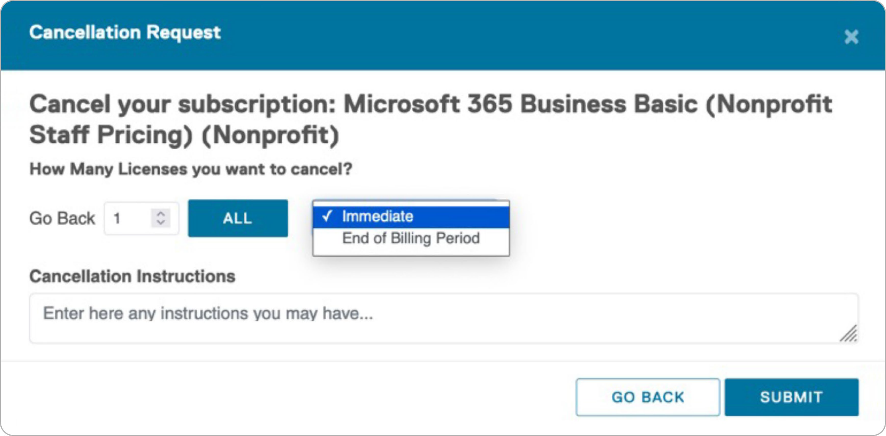
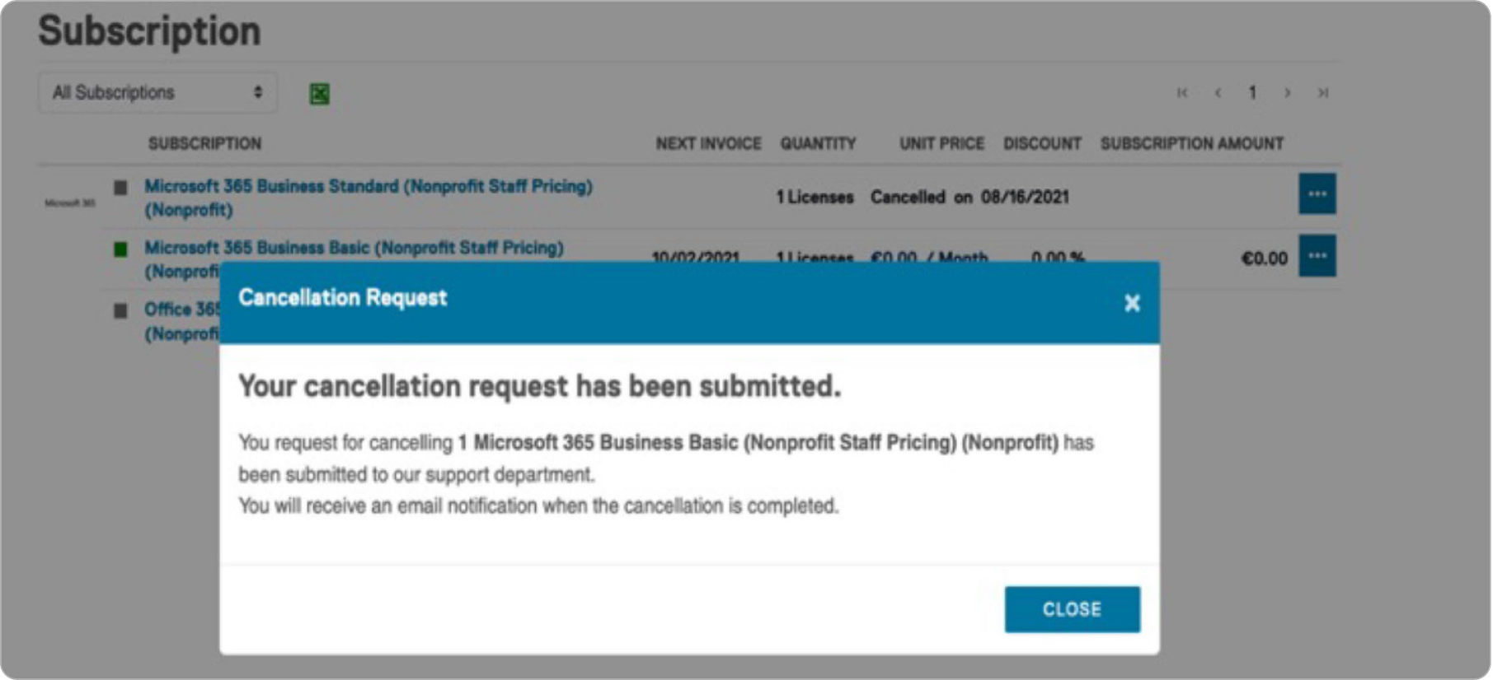
6
Click ALL
to cancel all licenses, select Immediate
as your effective date, and click SUBMIT.
7
You'll see confirmation of your cancellation submission.
Part 2: Retire Your Current TechSoup Licenses

Slide 18

How Can TechSoup Help You?
SERVICES
TRAINING
COMMUNITY
We have services that range from license activation, migration, security assessment, and setting up multi- factor authentication to a full Office 365 Complete Setup that will help you get up and running.
You can reach us via one of the following methods:
We offer training courses for nonprofit staff and volunteers on how to use Microsoft applications such as Teams, Excel, PowerPoint, Word, SharePoint, and many other applications.
Start learning: https://techsoup.course.tc/ catalog?type=microsoft-digital-skills-center
Be a part of our community!
http://forums.techsoup.org/cs/community/ f/112.aspx
Via phone 1-800-659-3579.
Monday through Friday
from 7 a.m. to 12 p.m. Pacific time
Create a support ticket: https://page.techsoup.org/office-365- support-services

Slide 19

techsoup.org

