Slide 1



Digital transformation for greater sustainability and social impact

Slide 2

Agenda
Defining Operational Excellence and Digital Transformation
Introduction to Business Models
Operational Excellence in action
Digital Transformation in action
Developing your technology strategy
Examples of digital transformation
Kickstart your transformation
We listen and encourage people to feel better: building resilience, fostering healthy relationships, and connecting people with community support.
2

Slide 3



Technology Strategy – It makes a significant difference to your impact
You’re going to invest in technology over the coming year, with or without strategy.
Developing a technology strategy dramatically improves your focus and the outcomes from your investment
Create greater empowerment, choice and outcomes for every individual and community you support
Increase reach to connect with more people who need your services
Build greater sustainability for your organisation
3

Slide 4
Driving Strategy - Operational Excellence or Digital Transformation
Operational
Excellence
Streamline back of house operations to drive efficiency and cost effectiveness
Better enable and mobilise your workforce
Deliver existing services with greater effectiveness and improve client experiences
Optimise your customer and community reach
Digital Transformation
Create new opportunities to fulfil your purpose, vision and mission
Position your organisation as the go-to leader in the space
Generate new revenue streams that monetise digital assets
4

Slide 5

Introduction to
Business Models
5

Slide 6
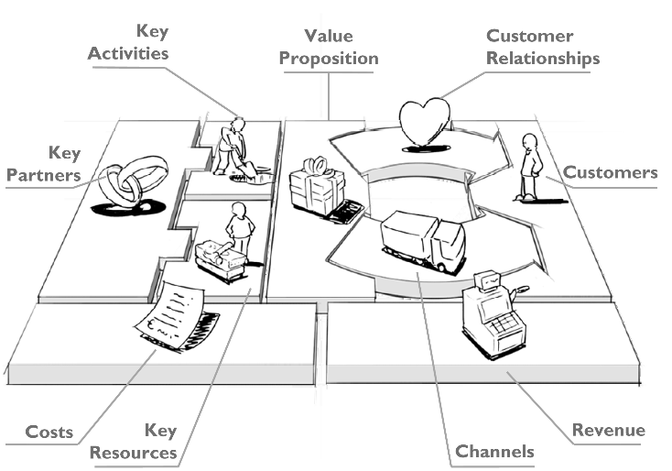
Introduction to Business Models
A Business Model describes the rationale of how an organisation creates, delivers and captures value
6

Slide 7





HFE Limited – An fictitious example
KP | KA | VP |  | CR | CS
 |  |  |  | CH
 | KR
C$ |  |  | R$
Housing Development
Housing Support Workers
HFE
Out Reach
Access to short term housing
Government
Housing Support Services
Our purpose
To provide access to affordable housing and support for individuals and families at risk of homelessness
Support Agencies
Management (HR/Finance)
Outreach and support services
Support Agencies
Individuals and families at risk of homelessness
Houses
Government waiting lists
Our People
Our People
Overheads
Government funding
Individuals
7

Slide 8

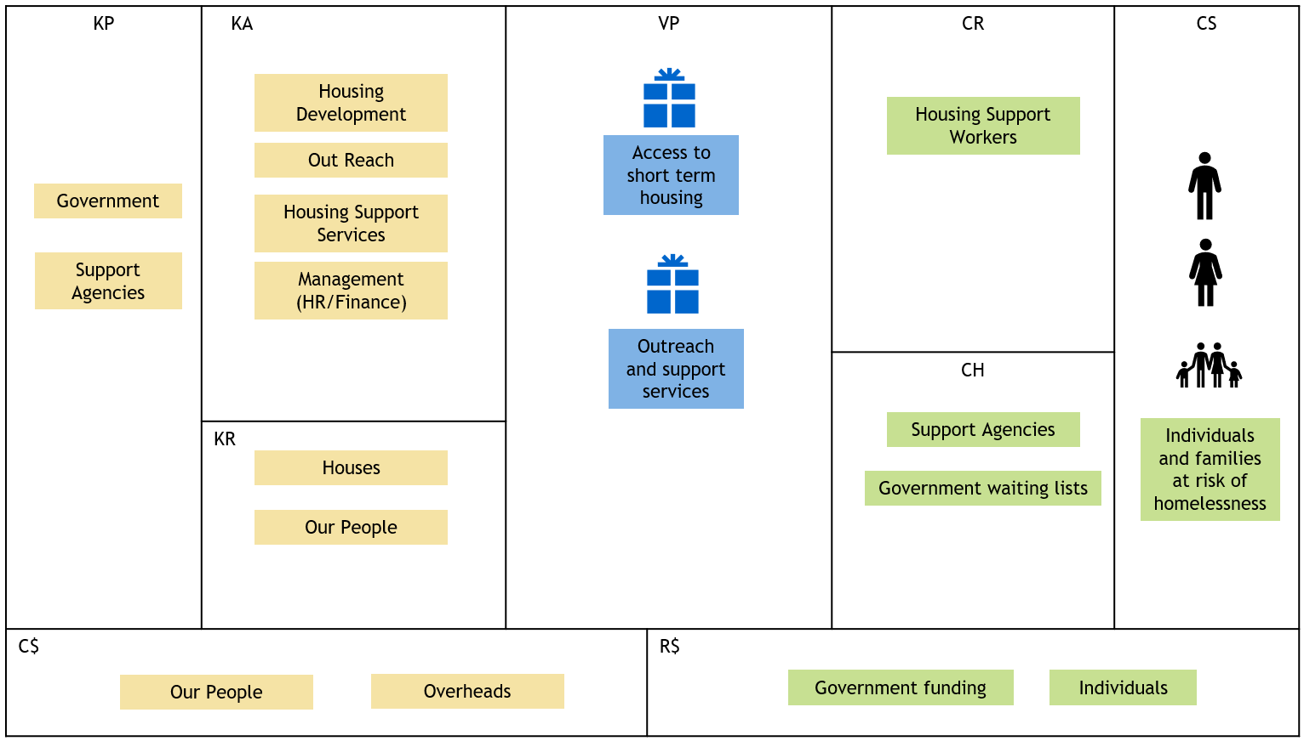
Operational Excellence in Action
Technology Strategy and Governance
Create operational efficiencies and reduce costs
Create value for individuals and communities
Generate additional revenue
IT Operations and Risk Mitigation
8

Slide 9
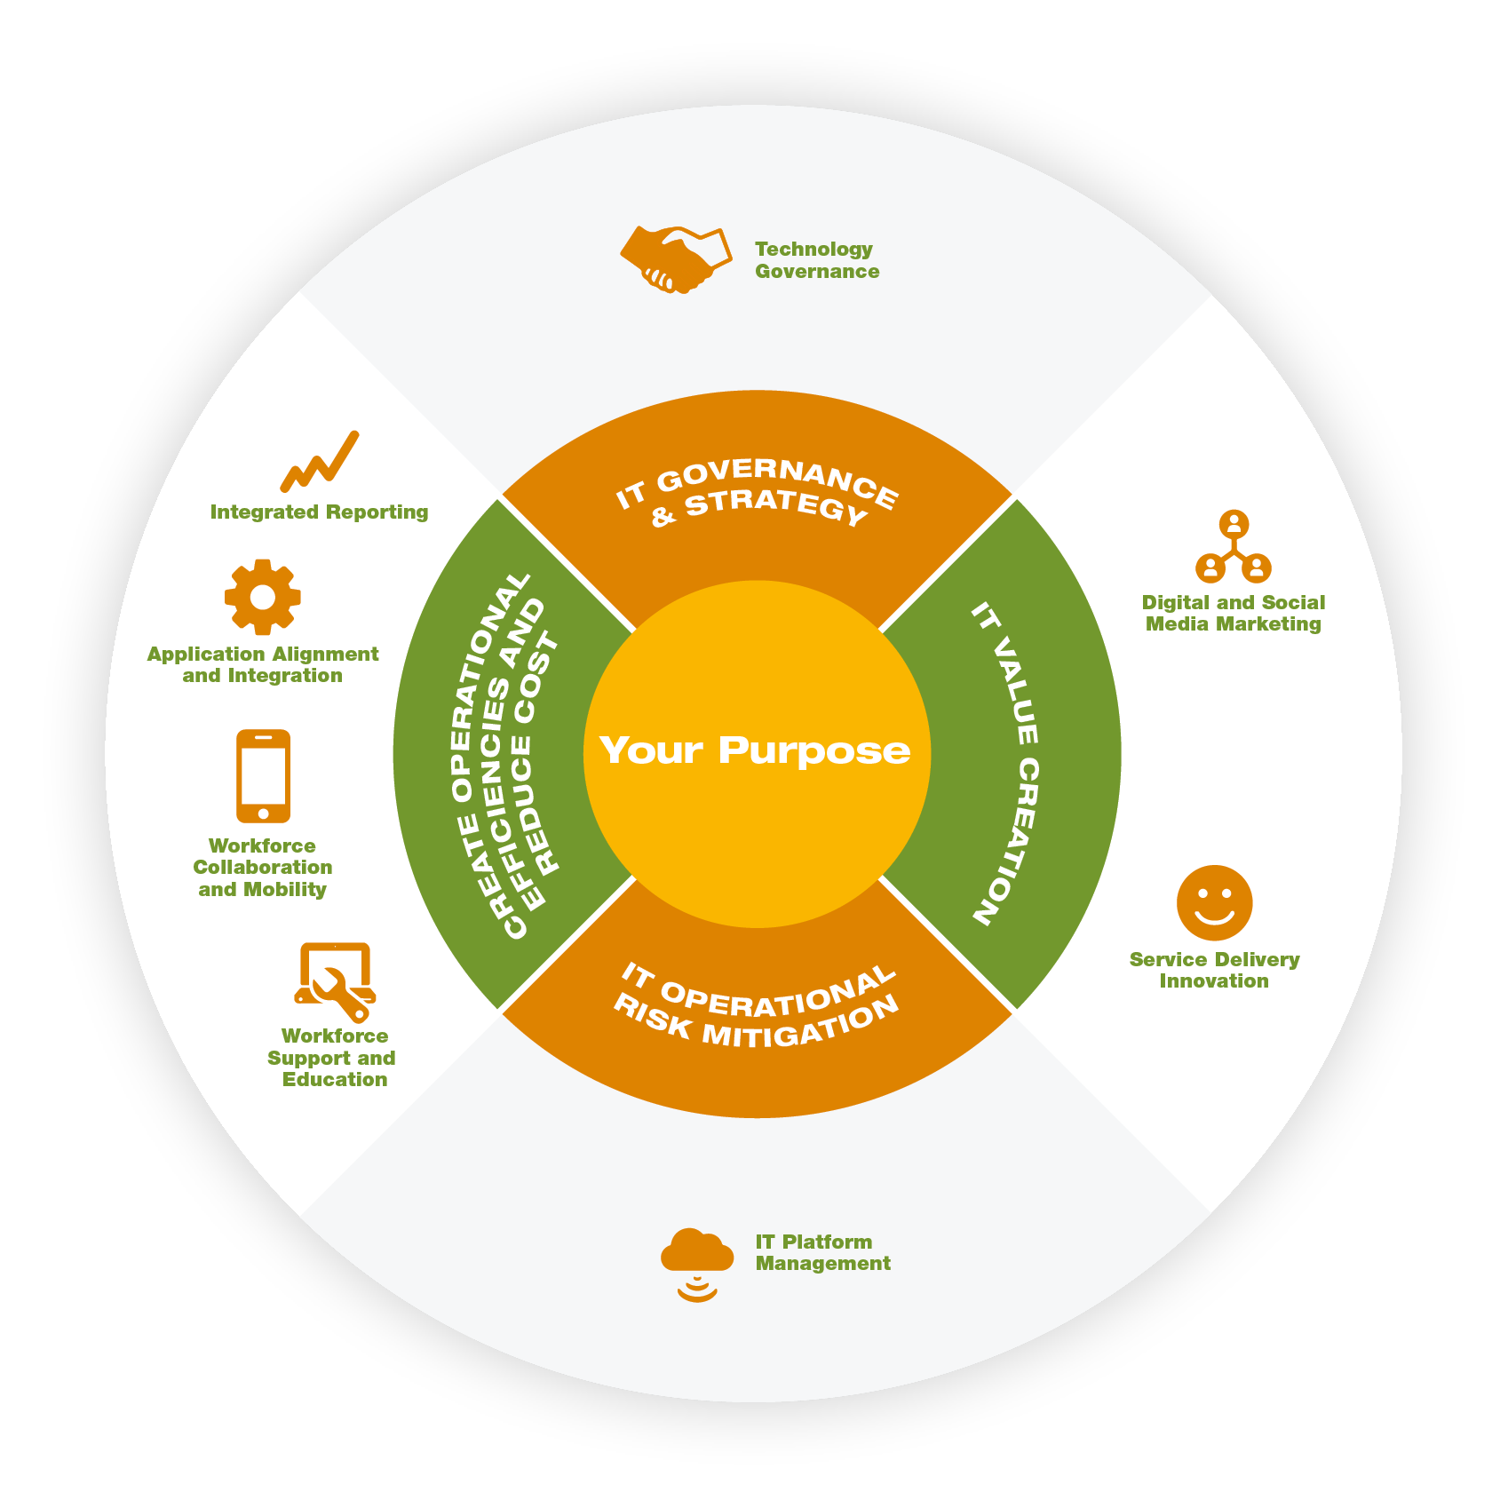
Operational Excellence in Action
Developed technology governance practises to oversee IT operations, manage risk and ensure IT projects deliver the expected outcomes
Matured data governance practises to comply with the NDB Scheme, protect customers privacy, and our brand.
Built a BI dashboard – provides their leaders with on-demand access to management reports across the organisation to drive informed and timely decision making.
Outcomes
Streamlined back of house operations to drive efficiency and cost effectiveness
Better enabled and mobilised the workforce
Outcomes
Optimised customer and community reach
Delivering existing services with greater effectiveness and improved customer experience
Leveraged web and social media to build a community across support agencies, increasing the ability to connect with people in need.
Leverage web and social media to share stories, engage funders, supporters, volunteers and attract talented passionate staff.
Integrated client management system with digital marketing, rostering, time sheeting, HCM, payroll and finance systems.
Standardised applications versions and provided training across the workforce.
Provided a web portal for support agencies to easily connect with Outreach team.
Provided housing support workers with full mobile access to systems – enabling them to spend more time with individuals and zero time in the office.
Implemented cloud based email, Intranet and knowledge management system.
Provided the workforce with mobile devices to enable the team to store, share, search information and collaborate from anywhere - whilst reducing the use of paper
Partnered with an IT firm with strong support capabilities and responsiveness. Educated their workforce how to stay safe and productive when using company systems.
Implemented a hybrid cloud (public could / private cloud) platform to keep systems secure, reliable, well performing and agile. Leveraged multiple datacentres for business continuity planning.
9

Slide 10

Digital Transformation in Action
Outcomes
Create a new opportunity to fulfil our purpose
Empower our customers with greater options and choice
Position our organisation as the go-to leader in the space
Increase our sustainability by generating a new revenue stream that monetises a digital asset
Corporate Partners
Grown / Maintain services directory
Provide individuals with direct access to search and choose the services they need
Online / mobile application
Services Database
(multiple providers)
Government funding
Corporate Partnerships
10

Slide 11
Building your technology strategy
11

Slide 12



Building your Strategy – Where do I start?
1
2
3
4
Business Model
Analysis and Digital Design
Document your current business model – understand clearly how you currently create impact and sustainably
Reimagine how you deliver on your purpose. Create a new value proposition(s) to deliver on your purpose, ones that leverage digital assets.
Assess your progress towards Operational Excellence
Leverage the Align IT framework to determine your current capabilities, risks and opportunities to improve operations and customer outcomes
Develop your Technology Strategy
Develop a vision for your future organisation. It may be about delivering existing services better (Operational Excellence) – It may be about reimaging your value propositions and creating new value (Digital Transformation) – or a balance of both.
Determine the initiatives required to bring your vision to life. You’ll have many!
Develop your Technology Roadmap
Develop the roadmap of technology and change initiatives to bring your strategy to life
Prioritise the initiatives across 3 timelines:
Mitigation of operational risk
Operational Excellence
Digital Transformation
12

Slide 13
Digital Transformation Examples
13

Slide 14



Examples of digital transformation
Organisation |  | Mission |  | Digital Services
 |  | B1G1 is a social enterprise and non-profit organization with a mission to create a world full of giving |  | Online platform that enables small and medium business to embed giving opportunities into the everyday business operations. 2200 members and 158 million impacts to date
 |  | Social Traders exists to create jobs for disadvantaged Australians by linking business and government buyers with social enterprises. By 2021 Social Traders goal is to create 1,500 jobs for disadvantaged Australians |  | Created a community of 95 business and government buyers and 600 Social Traders certified suppliers and facilitating $105 million in procurement spend
 |  | Work with community, government and corporate partners to solve family violence, homelessness, mental health and issues facing people with disabilities, the elderly, Aboriginal, Maori and Pasifika communities |  | With a study by the University of Sydney finding that almost 80 per cent of homeless people own a smartphone, Ask Izzy provides access to a comprehensive directory of services so those who are homeless, or at risk of homelessness, can find what they need.
14

Slide 15
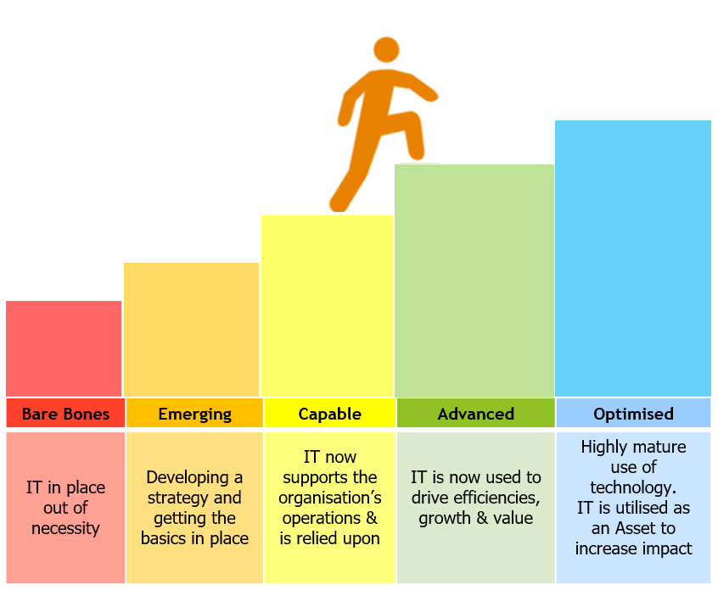
Transformation Kickstart (Limited availability of 5)
Operational Excellence Online Self-Assessment - You’ll learn what steps you can take to reduce risk, create operational excellence, and leverage digital thinking to increase your impact and sustainability.
8 hours of consulting time with Human IT to deep dive into your self-assessment and work with you to kickstart your journey
Some great resources
Exponential Organisations - https://exponentialorgs.com/
The Business Model Canvas - https://strategyzer.com/
The Align IT Whitepaper - https://www.humanit.com.au/align-it-whitepaper/
15

Slide 16












Everything we do enables purpose driven organisations to become effective,
efficient and maximise social impact
As a proud B Corp with over 17 years in the industry, we’re one of the few organisations that covers the full spectrum of IT services - from Strategy to Transformation to Keeping IT Performing Well.
We thrive on helping organisations increase social impact and deliver amazing service.
For further information please get in touch.
Ian Patterson
Managing Director | IT Strategist
258A Coventry Street South Melbourne VIC 3205
Phone: 1300 13 80 40 | Mob: 0412 959 998
Ian.patterson@humanit.com.au
www.humanit.com.au
16

